Slide 1
Agenda
Digital Council agenda Last demo day updates; Innovation approach and themes
10 mins
Digital Innovation: New Themes
Micro investment
Personal Finance Management
Investment games
Demographic Expansion
Accelerator
45 mins
Industry Benchmarking: Indian and Global Peers
Digital Onboarding
Digital Advisory (Robo)
API and Trade ecosystem tools, strategy builder etc.
International broker firms’ Products ideas
45 mins
Digital Demo: Fintech Startups
Tauro Wealth
Gumption Labs
20 mins
Digital Council: Decisions, approvals and next steps
10 mins

Slide 2
Last demo day updates; Innovation approach and themes

Slide 3
Ideas Already Identified - 1
Cross-Sell & Up-Sell Strategy
Goal & Solutions Based Advisory Automation for Insurance Products
Working with Hyderabad based FinTech: Habitual.AI - 3LOQ Labs
Capability:
Devising a Big Data system for analyzing customers transactional data across all products to come up with personalized Product/Feature recommendations & deliver those to the customers with an Omni-channel approach
Aim to drive Cross Sell, Up Sell, increase customer engagement, improve retention & loyalty.
Timeline:
1st Set of Recommendation complete by 23rd July.
Expected to complete the POC by 15th August, 2019
Working with Nvest Solutions
Capability:
Develop modules for Goal & Solutions based advisory of Investment Products to start with Insurance products – Life, Health, Others
Drive Insurance product distribution by end to end advisory solution for generating Quotations & performing transactions with Principals directly
Timeline:
Development is Progress
Expected to complete the testing by 15th September, 2019

Slide 4
Ideas Already Identified - 2
Held Away Asset Consolidation, Portfolio Aggregation & Optimizer
Marketing – Web Personalization & Customer Referral Program
Evaluation in progress for In-house.
Gumption Labs was the earlier selection.
Capability:
Solution helps consolidate Client portfolios in all asset classes held away with other advisors or brokers
Help increase Wallet Share with ISEC by effective advisory
Timeline:
Our Tech Team is working on it
Evaluated Notify Visitors
Capability:
Drive cross sell & up sell with effective personalization of the Website & Mobile App
Use Marketing Journey Building Tools, different landing pages, Conversion rate optimization tools like Heat-maps, Form Analysis etc. for better marketing approaches
Drop lead nurturing, Drip Marketing
Timeline:
Evaluation completed
On hold, will be taken up after the marketing automation implementations

Slide 5
Ideas Already Identified - 3
Partnership with smallcase
Evaluated Business case for smallcase partnership
Capability:
Provide Thematic Investment Portfolios to customers via the B2B2C model
New source of order flows & customer acquisition
Presence at par with the Competitors/Peers
With API Ecosystem looking for more partnerships & collaborations with FinTech’s & B2B players
Timeline:
Evaluation completed.
Based on Feedback of HODs decided not to go ahead.

Slide 6
Innovation Themes and Accelerator

Slide 7

Micro Investment

Slide 8
Micro-investment: Investment = f (expense)
Micro-investment is a robo advisory model that builds investor savings through small, incremental investments on a pre-scheduled or ad-hoc basis and invests that savings to help them build wealth gradually
Every time a user does a digital transaction, the app rounds up that amount to the next hundred and puts that extra change into an investment account.
Once the amount in the virtual account crosses Rs. 100, that amount will be debited from user bank account and will be invested in MF.
Appendix

Slide 9
Themes: Micro Investment
Financial Discipline
Save the Change
Linking saving with spending : Offsetting guilt spends with savings
Fractional investments : Rounding off digital spends to nearest 100’s or 1000’s
Stock-Back/ETF
SIP the TIP
Tie up with companies for rewarding loyal customers with stock-back/ETF’s
Investing the tip amounts received by Zomato/UberEats employees
Micro
Investment
Themes
Reward Point Redemption
Ola/Uber
Credit card reward point redemption like Payback through ETF’s/MF’s
Investing a portion of drivers salary/incentives
Appendix

Slide 10
Target market
Simple, the number of millennials—or people born between 1980 and 2000 is huge and they live largely by one mantra: spend, spend, spend.
As per Census data, the Millennial population of India is around 450 Million out of which around 150 Million live in urban India
In departure from the previous generations, savings account for only 10% of both overall and incremental income of the millennials, thus providing a consumption boost
While most of the monthly income of the millennials is spent on essentials, followed by education and utilities, the incremental income is primarily spent on entertainment and eating out (32.7%), apparel and accessories (21.4%) and electronics (11.2%).
These customers are tech savvy, culturally diverse, well-travelled and high-income urban dwellers, working in new technology jobs and open to new concepts and ideas
Urban
Millennial Population
Appendix

Slide 11
How Success looks like
Founded : 2012
Number of users: 4.5M
Total Funding Amount: $207M
Valuation: $900M
Founded : 2015
Number of users: 2.5M
Total Funding Amount: $181M
Valuation: $350M
Indian Fintechs
Video
Appendix

Slide 12
Personal Finance Management
Appendix

Slide 13
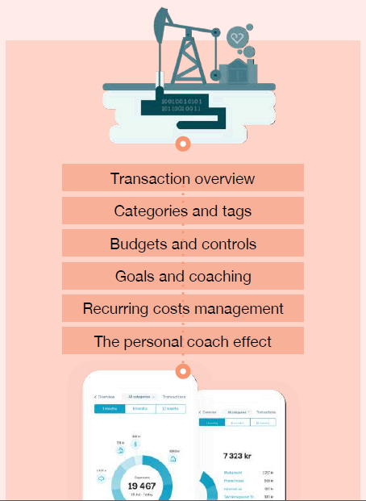
Problem Statement : Personal Finance Management
To capture the Whitespace in PFM, for Analytics driven Financial Planning, Advisory & Up/Cross Sell
Drive advisory with the deep Analytics Touch from the Customer’s PFM data
Help people understand their finances, empower them to make smarter decisions and, ultimately, bring financial happiness!
Increase customer engagement, trust & loyalty
One Size does not Fit’s All
Diverse Goals & Demographics
Family | Young Generations | Retirements
Varying Sources of Income, Levels of Income & Spends
Suitable Financial Solutions mapping Customer Profiles & solving for real life goals is missing!!!
Appendix

Slide 14




Market Size & Opportunity
Savings & Investment gap of $54 Billion
Traditional ways : Gold & Chit-funds
Returns: -8.5% to 4%
Liquidity Cost: High
Risk: High
Saving Protection: Nil
Lower Penetration of Protection Products
Traditional ways: Endowment plans that offer inefficient returns
Penetration: Just < 3%
Liquidity Cost: High
Unmet Credit demand of $740 Billion
Traditional ways: Primary access to joint liability groups, Chit funds
Inflexible in : product size, tenure & repayment schedules
Informal Loans: Extremely high cost
600 Million Customers in India for whom Financial Solutions can play an important role in solving real life problems
Opportunity size of huge base to increase penetration for Investment, Protection & Lending Products by making Financial Planning available to the Masses
Make Finance more intuitive by offering Solutions rather than just selling Mundane Products to help them achieve Real-Life Goals
Source: Economic Survey of India, FY2020
Appendix

Slide 15







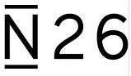





Players in India & Global
Global Players
Indian Players
Valuation: $140 Million
Founded: 2010
Users: 5+ Million
Acquired by InTuit recently
Valuation: $15 Million
Acquired by PayTM
Valuation: $100 Million USD
Founded: 2013
Users: 1+ Million Users
5+ Million Downloads…
5 Million + Downloads
+ Some Bank’s as well…
+Some Global Banks…
Appendix
Notes:
Change this slide

Slide 16



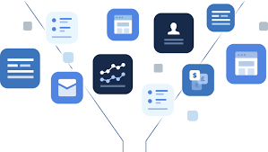
Appendix
Execution Model
Collect The Data
Enrich The Data
Present The Data
Act on The Data
Discover internal data
Collect data-points across all Bank’s, Credit & Debit Cards, Financial Institutions (NBFC’s), Credit Unions (via SMS, API etc.)
See which of our customers do business with our competitors
360 Degree View of the Customers Financials across all FI’s
Transactions cleansing, categorizing & classifying
Run analytics with enhanced AI/ML models to derive insights
Consolidate clients Assets & Liabilities across FI’s to help increase Wallet share for us!
Aim to become the primary one-stop Financial hub – All accounts at one place.
Visualizations for Spend categories, Budgeting, Cash Projections etc.
In-App Gamifications like Fitness Trackers, Lifestyle planning, Diet Planners etc.
Drive Digital Robo-Advisory with deep Analytics insights
Drive Complete Financial Planning for Goals based Advisory
Hyper-personalized Product/feature recommendations for Cross Sell/Up Sell (Insurance, Bonds, NPS, Digital Loans etc.)
Engage customers with Brand’s couponing & offers, Payments

Slide 17
Investment Games –Stock Premier League
Hyperlink

Slide 18
Objective : Stock Premier League
Explore it as a new line of business and make revenues by charging a participation fees from customers
Reach out to Gen Z and young working class customers who have the potential to become our future clients.
Reach out to customers who do not have the money to trade in the stock market but want to take bets on the same
Use gamification (leaderboards, live feed, daily winners etc.) to make the experience even more fun and engaging
Hyperlink

Slide 19
Operating Model
Download App/Visit Website
Create Account or Login Via Facebook / Gmail
Before 9 a.m. on trading days
You have the best performing portfolio today?
Create a dummy portfolio of 10 best stocks from the index
Using virtual money
Select Index on who’s constituents you want to place a bet
Pay Rs 50 as participating fee and enter the contest
Verify Mobile / Email via OTP
Login
No
Yes
Participate again next day
Win INR 50,000 Daily Cash Prize /
Hyperlink

Slide 20

Deep Dive
The Market:
Market Size: $ 1 Bn ¹
Opportunity Size: 4 – 5 Lac customers per year
Target Audience: College going students and young working professionals ( 18 – 30 yrs)
Expected Revenues: 160 Cr / Yr
Regulation and Law
SEBI View: SEBI got BSE and NSE to issue advisories asking investors to do it at their own risk. “Such schemes are neither approved, nor endorsed by the exchange” ²
Prevalent Law: Games of mere skill are exempt from the provisions of the Public Gambling Act, 1867 (PGA)
Execution Strategy:
Refer Operating Model
Build own mobile app
Partner with existing player like Dream 11
What success looks like³:
Founded : 2008
Number of users: 52.5 Mn
Total Funding Amount: $100Mn (Series D)
Valuation: $1Bn
Net revenue: $100 Mn
First Indian gaming startup to enter the unicorn club
1. Economic Times Article dated Mar 23, 2018 – Market Size of Fantasy Gaming Companies
2. Time of India article dated Aug 26, 2016
3. Times of India Article dated Mar 24, 2019
Hyperlink

Slide 21
Demographic Expansion

Slide 22
Fintech | Unique Proposition
1. Fingpay | Tapits Technologies is a Fintech Company working towards financial inclusion Provides an agent assisted solution, which facilitates digital payment of fees, recurring bills, etc. using customer’s Aadhaar number and biometric authentication Targeting Rural consumers who are more oriented towards savings Over 50000 merchants using Fingpay platform for cash deposit and remittance facilities primarily from North - East region of India
2. Udaan | Fastest Indian start up to be valued above $1bn Provides B2B ecommerce platform for manufacturers to sell directly to shop owners and merchants Delivers to over 500 cities and picks up sellers from over 80 cities Connects over 1.5 mn traders, retailers and wholesalers in India

Slide 23
Accelerator
Hyperlink

Slide 24
Execution Setup - Accelerator
The Flow
Identify Themes / Use Cases
Onboard/Invest in Selected Startups
Invite Applications
Filter Startups
Accelerator program
Funding
Related to improving efficiency, margins etc in existing business
Related to exploring new lines of business
Related to RPA
Via dedicated website
Media Announcement
Announcement on platforms like INC42, YourStory etc
3 Stage selection process
Selection by panel of experts from within the company and outside the company
Criteria:
Relevance vintage, pedigree, funding status, team size etc
Agreement
NDA
Term Sheet for investment
Provide infrastructure
Host On Premise / On Cloud
Active mentoring once / twice a week by BU experts from I Sec
Continuous evaluation and testing of their solutions w.r.t our use cases
Get deployable solutions for our use cases as an output
Organize a demo day for VC/PE Investors
They invest at a higher valuation
Co invest* in subsequent rounds OR exit the investment
Startups stay connected as Alumni of the accelerator
Hyperlink

Slide 25
Accelerator Setup
Investment Solutions
Entrepreneurs & VCs
DC Members
BU Experts from I Sec
Industry Experts outside I Sec
Artificial Intelligence
Machine Learning
Dedicated Website
Robo Advisory
Mentors
Online Repositories
Process Automation
Startup Sourcing
Thrust Areas
Blockchain
College Competitions
I Sec Accelerator
Digital Onboarding
Secondary Stake Sale
Exit Strategy
Investment
Dedicated Corpus
IPO
CSR Funds
Structure
Ecosystem Partners
Selection Partner
/Co Investor
8 – 10 Startups / cohort
Infrastructure
Media partner
2 Cycles / year
Legal partner
8 -10 week program
Co working space
Educational Institutions
Office Space & ancillary facilities
API
Cloud
Sandbox
Hyperlink

Slide 26
Accelerator
Startups with:
I Sec validated solution
An operating framework
ROI Metric
additional business in terms of clients / revenue to I Sec
improvement in customer engagement for I Sec
Improvement in process efficiency / reduction in cost
get the startup funded in 9 – 12 months by other investors
successful exit after 3 – 5 years with an IPO or a secondary stake sale
enable startups to generate revenues / profits from clients other than I Sec
API / Cloud / Sandbox
Accelerator
8 – 12 week cohort based program where participant startups:
Get Mentored
Pitch to a panel of investors
Raise seed funding from ICICI Securities in exchange for equity
Receive educational and technical Assistance
Participate in skill building workshops
Network with industry experts
Startups with:
established proof of concept
Ready prototype
Public Pitch Event
Demo Day for investors
Hyperlink

Slide 27
Timeline – Plan of Action
LAUNCH MICROSITE
CLOSE APPLICATIONS
SCREENING
BOOTCAMP
Aug 10th, 2019
Tentative
2 weeks from launch
2 Weeks after applications close
2 Weeks after Fintechs are selected
Finalise Themes and Use Cases along with business
Open applications
Hyperlink

Slide 28
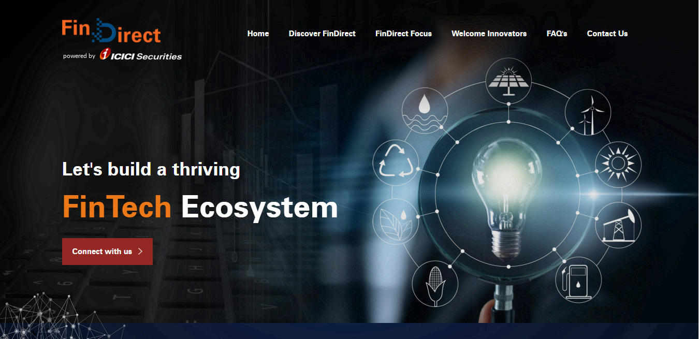
Microsite Homepage
Hyperlink

Slide 29
Sample Themes
Aditya Birla Bizlabs:
InsureTech :
Solutions that engage with customers to improve their health outcome e.g. smart monitoring of diseases and lifestyle issues, incentivizes healthy lifestyle, offers access to wellness providers.
Lending Tech :
Scalable segment specific digital lending solutions: e.g. supply chain finance solutions enabling on-boarding of corporate/SME anchors and their supply chain partners, real-time underwriting and monitoring.
Employee Tech:
AI based solutions that offer 'Recruitment tech' to enhance hiring effectiveness and talent retention using behavioural assessment, success prediction, etc.
AI based solutions that offer engagement analytics to predict attrition and performance potential via sentiment analysis, performance patterns, leave trends, etc.
Yes Bank Fintech Accelerator:
Digital Payments :
Instant Cross-border Remittance Solutions [FEMA Compliant]
P2P Payments
Cybersecurity:
Fraud Risk Monitoring and Prevention
Use gamification (leaderboards, live feed, daily winners etc.) to make the experience even more fun and engaging
Big Data and Analytics:
Voice to Text Solutions
Risk Monitoring/Credit Portfolio Analytics
Reporting Solutions with Smart UI/ UX
Wealth Tech and Invest Tech
Robo Advisory Platform
Multi-channel Customer Engagement [Onboarding, Order management, Reporting etc.]
Hyperlink

Slide 30
Industry Benchmarking: Indian and Global Peers
Hyperlink

Slide 31
Digital Onboarding

Slide 32
Objectives – Digital Onboarding
100% digital onboarding experience to prospective clients
Reaching out to clients who are as of now out of our reach : Millennial, Tier 3 & 4 cities, Rural
Target increasing monthly New Client Acquisition manifolds from the current 30-35k per month.
Reducing the Cost of Acquisition (Use of digital channel)

Slide 33

Account Opening Flow (Trading in 30 Minutes)
Fill in basic details :
Name
Phone Number
City
Enter proof details:
PAN
AADHAR
Date of Birth
Chose brokerage / prepaid plan
Link Bank Account
(Search Bank by IFSC / MICR)
Fund Transfer Via:
Net Banking
Debit Card
UPI
Select Segment and Net worth:
Equity
FnO
Commodity
Currency
Fill in personal Details and accept FATCA :
Address
E mail
Gender
Annual Income
Father’s name
Mother’s name etc.
Upload proofs for verification:
PAN AADHAR
Photograph
Signature
(Instant chat popup from a company representative showing that documents uploaded are being verified
Account is ready for trading in half an hour.
User ID and account details shared via email
eSign the application using Aadhar through NSDL eSign Service
Add a nominee

Slide 34

Account Opening Flow (Trading in 12 Hrs)
Fill in personal and FATCA Details:
Gender
Father’s name
Mother’s name etc.
Educational qualifications & occupation
Correspondence Address
Input KYC (PAN, DOB, contact no. & email id) and Bank account details. Verification done in the same step
Select Segment and Account Plan:
Equity
FnO
Commodity
Currency
Enter mobile number
Enter basic details:
Name
Email
Password
Agree to T&C
Agree to getting free Bharat 22 ETF
Upload proofs for verification:
PAN
Photograph
Signature
Bank Proof
Financial Proof
eSign the application using Aadhar through NSDL eSign Service
Start trading next day

Slide 35
Takeaways and Recommendations
Currently, industry peers:
Accept multiple modes of payment while charging account opening fees (UPI, Net Banking, Credit Card, Debit Card etc.)
Have a simple online account opening form that requires client to enter minimal details
Auto fetch details using KRA and IFSC/MICR code
Use eDIS for enabling instant trading
Do eKYC via UIDAI or Digi-Locker
Reduce TAT, Make the account ready for trading within 30 mins of digital on-boarding through any bank account
Accept uploaded documents in multiple formats like png, jpg, pdf, etc.
Have moved towards innovations by allowing facial recognition and finger print etc for login purpose.
Can we do this?
Notes:
Updated

Slide 36
Digital Advisory (Robo)
Hyperlink

Slide 37
Objectives – Digital Robo Advisory
Focus on Retail and Mass Affluent customers
Augment and Optimize existing Services
Goals-Based Financial Planning and Advisory to customers
Improved Customer Engagement
Improve Cost to Income ratio
Rapid Growth in Assets Under Advisory (AUA)
Hyperlink

Slide 38
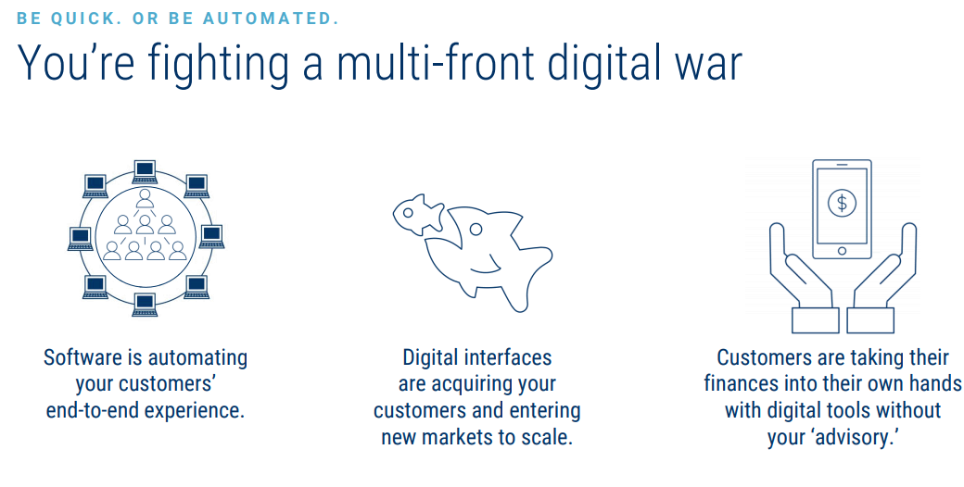
Why Robo Advisory?
ICICI Securities Human Capital:
1200+ Relationship Managers
418 Personnel’s in Support Functions
45 Retail Broking Research Team
199 Number of Branches
Start-up’s iterating repeatedly to lower fees & acquire customers
There’s no shortage of digital insurgents to keep us up at night.
Hyperlink

Slide 39






























Market Mapping - India
B2B
B2B2C
Brokers
B2C
Robo Advisory – Large Global FI’s
30+ Robo Advisory & Investment Platforms in India
Ranging from PFM Solutions, Robo-Retirement Solutions, Credit, Tax Planning, Real-estate advisory, Lifestyle advisory, Will Drafting etc.
Hyperlink

Slide 40
Strategic Options
1. B2B – Buy & Build with B2B Offerings
2.B2B2C – Alliance/Partnerships
Others alike…
Execution Steps:
Offering Evaluation
UX/UI decisions and API Integration
UAT
Go Live
Execution Steps:
Business proposition analysis
Alliance/Partnership Strategy
API Integration
Go Live
Hyperlink

Slide 41
DIGITAL DEMO: FINTECH STARTUPS

Slide 42

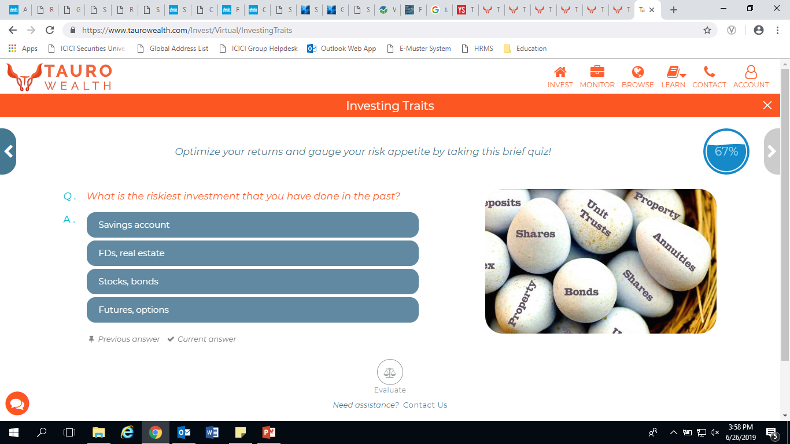
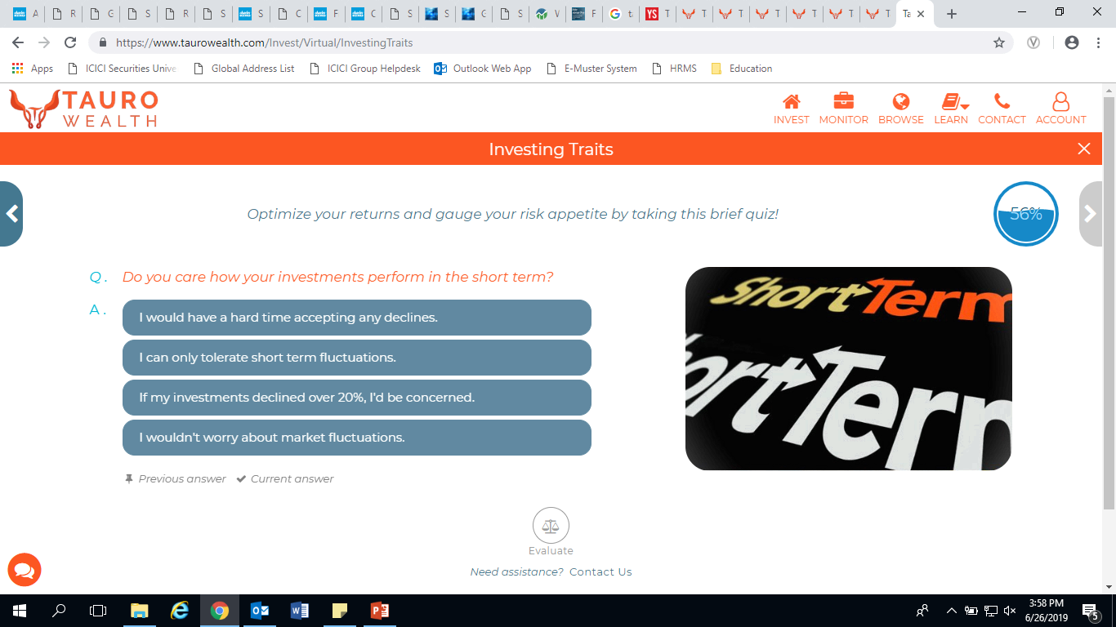
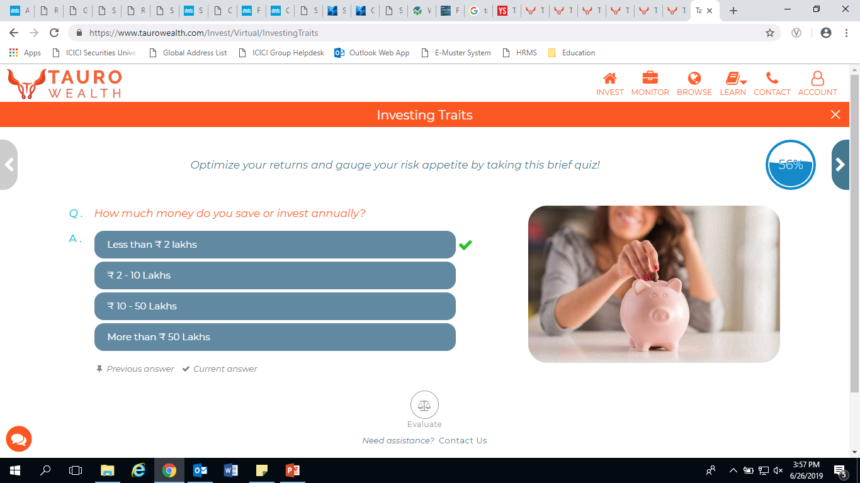
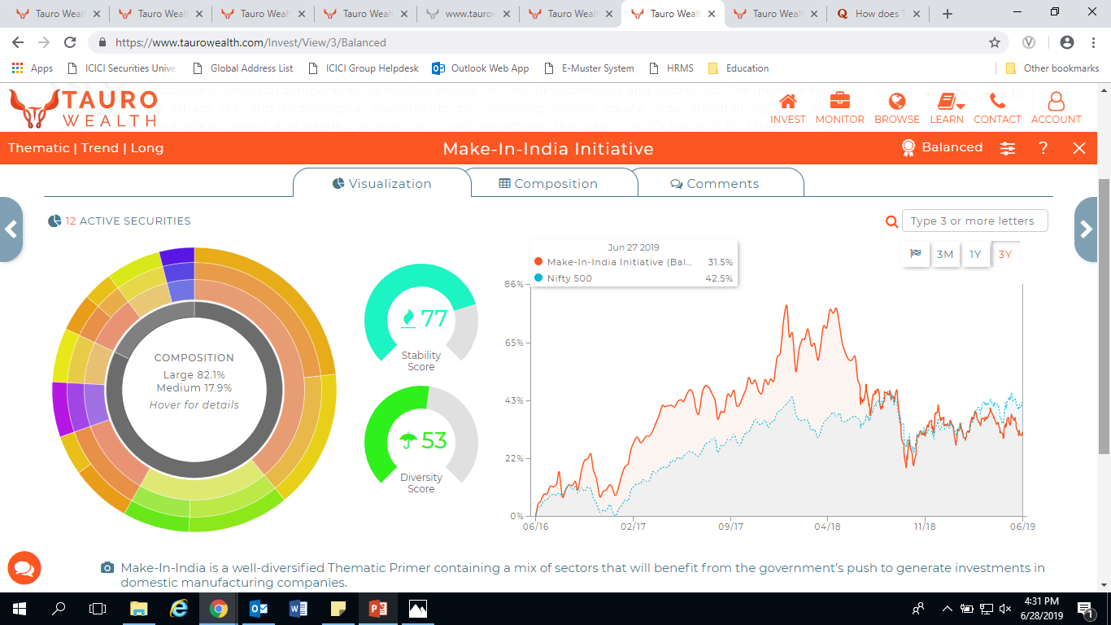
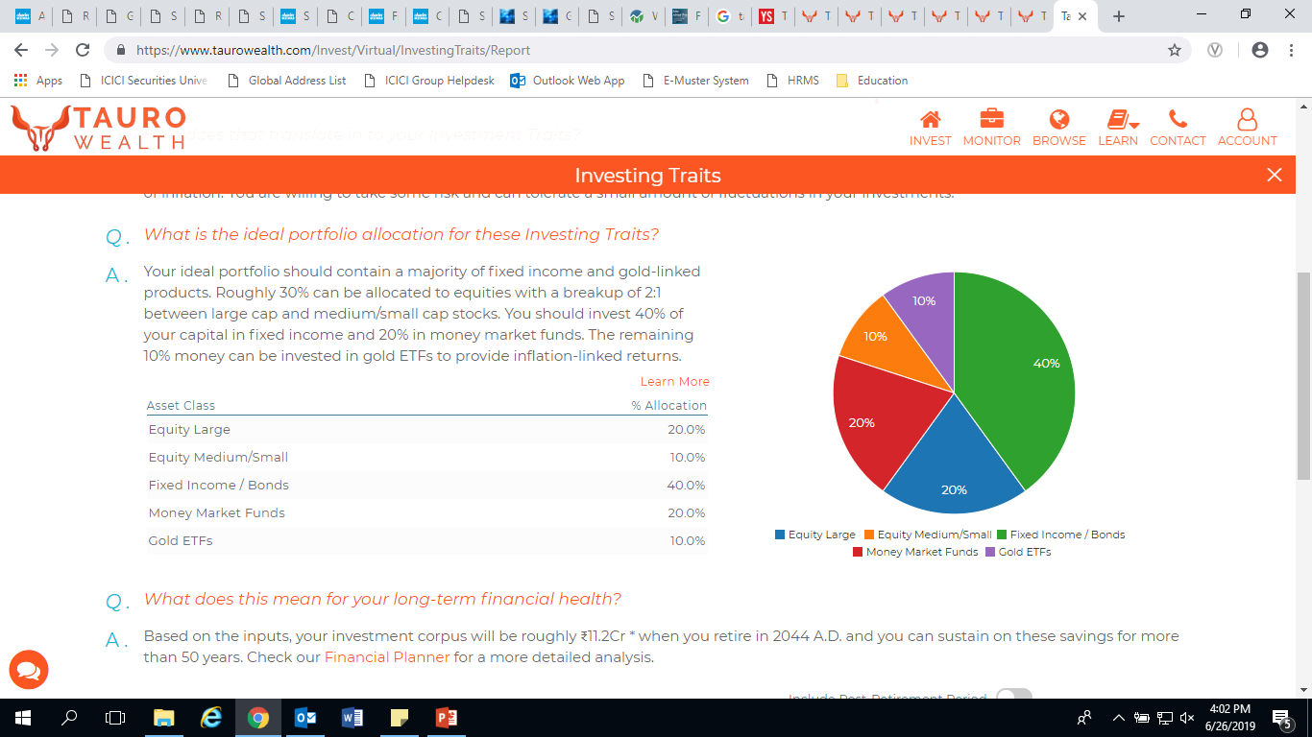
Tauro Wealth – B2B
Step By Step Risk Profiling
Personalized Recommendations - Based on the Investing Traits (Risk profile) Asset Allocations – Direct Equity & Debt Mutual Funds
Personalized Primers → Thematic Portfolios in Direct Equity (3 Variants – Aggressive, Moderate, Conservative)
Single Click Customized Calendar re-balancing, SIP Investing
Intuitive Visualization's
Hyperlink

Slide 43
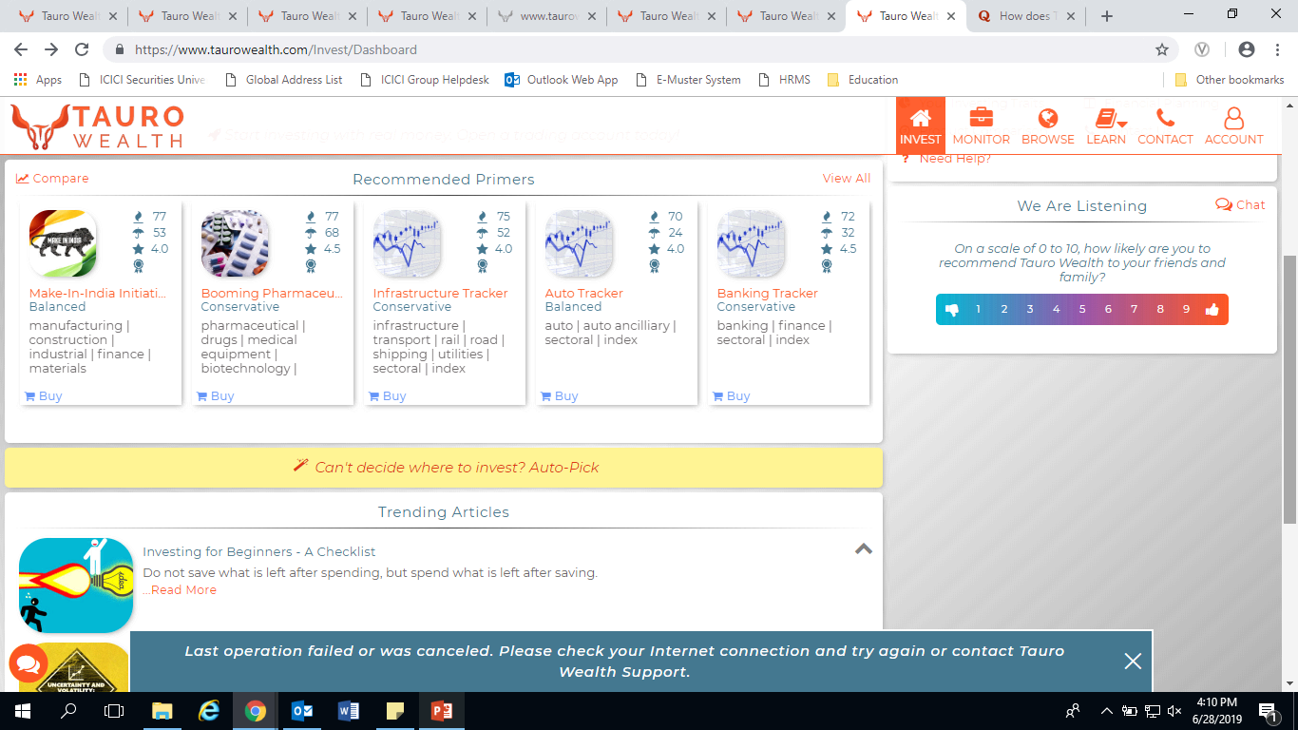
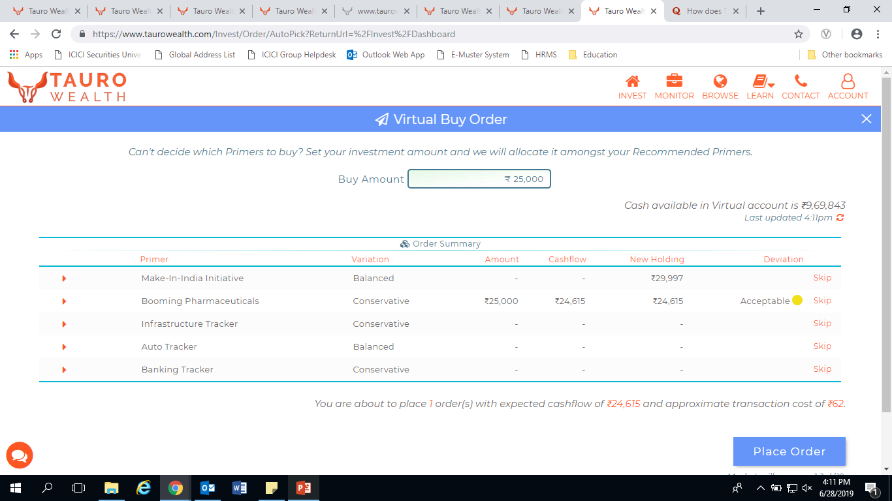
Thematic Primer’s
Single Click to Invest or Rebalance

Slide 44
API and Trade ecosystem tools, strategy builder etc.
Appendix

Slide 45

Key Themes:
New Business Lines
AI/ML Use-cases
Block-chain Use-cases
Alliances:
PFM Apps
InsurTech Start-ups
EdTech Start-ups
B2B2C:
Thematic Baskets
Robo-Advisory
Trading Tools:
Screeners
Algo-trading
Options Strategies
ISEC FinTech Accelerator
Ashwini Joshi
Digital Ecosystem
Sudhir Kumar Jha
Open Architecture APIs
Akshay Rote
Open API’s:
Login API’s
Trading API’s
Watch lists API’s
Order API’s
Holding API’s
Data Sandbox:
Market Data
Anonymized & aggregated customer data
Historical data
Appendix

Slide 46
API Based Products
Appendix
Upstox (since 2018) | Product Feature
Ami-broker | Chart based trading using AFL
FOX Trader | Advanced Back-testing & trading
Trade Rays | Technical based Algo Trading
Dart Stock | Watch lists & Scanners
Zerodha (since April 2016) | Product Feature
smallcase | Thematic Portfolios
Sensibull | Options Trading Platform
Streak | Technical based Algo Trading
TickerTape | Fundamental Screeners
Others : Sentinel, GoldenPi, Digio & 5+ FinTech’s…
ICICI Bank | Connected Banking
Zoho | Complete ERP System
Happay | Corporate Expense Management
Pay Books, greytHR | Payroll & HR Accounting
Accountable, Marg ERP, Open, Accountable | Business accounting, Book keeping, GST Invoicing etc.
Others: ePayLater, Bitgram, FingPay, Signzy & 30+ FinTech’s…
Yes Bank | API Use Cases
SAP | API Banking - ERP integration
Tally | API Banking – Book keeping integration
IIFL | NBFC Instant Gold Loans
Snap Deal | eCommerce Instant Refunds
Others: Karza, Pingal, Balance, FinBit, Fyle & 20+ FinTech’s…
Notes:
GoldenPi – Fixed Income Platform

Slide 47
Objectives – Trading Ecosystem
Enable novice customers to build strategies in equity and F&O using simple DIY tools
Enable advanced traders to build and test complex strategies : Niche Segment
Provide strategy building tools for active engagement
Appendix

Slide 48
Trading Ecosystem Modules
Trading Ecosystem | Description | Broker | Fintechs Explored
Strategy Builder | Helps build multi-factor investment models which can be chosen from a pre-built library or created by the investor. It enables traders to define and evaluate strategies using both fundamental and technical analysis. | Motilal Oswal, Upstox, Zerodha, E*Trade, Fidelity, Charles Schwab | Gumption labs, Uforic, Sensibull
Algo Modules, Automated/Robo Advisory, Technical Tools | Helps provide financial advice or investment management online with minimal human intervention. Advice is provided based on mathematical rules or algorithms | Sharekhan, Angel, Kotak, Fidelity, Charles Schwab, E*Trade | Gumption Labs, Tauro Wealth, Wealth Objects, Bambu, Welnvest, Heckyl
Charts | Tool for technical analysis and providing real time transaction options | Sharekhan, Motilal Oswal, Zerodha, Upstox, IIFL, Angel, Fidelity, E*Trade | ChartIQ
Appendix

Slide 49
Recommendations– Trading Ecosystem
Buy B2B solutions with strategy / robo experts
Partnering with / buying early stage Fintechs that can build products as per our requirements
Developing various tools and strategy builders in house
Appendix

Slide 50
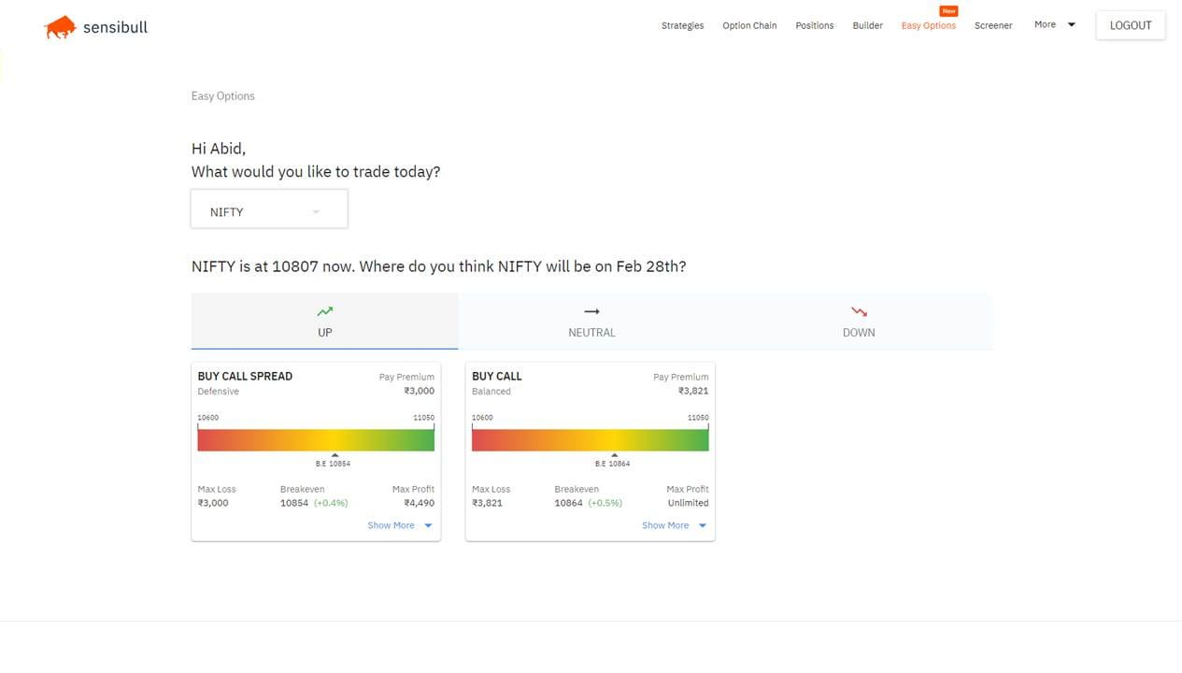
Sensibull
Features:
Data & Analytics
Scanners, Screeners, Greeks, Market Data Analysis, Option Chain, FII Data, etc
Advanced Statistics and Probability
Greeks, IV, IVP, HV, Standard Deviation, Probability of Profit, PCR, Max Pain
Better Order Execution and Alerts
Multileg Basket Orders
Conditional Order Execution - If this then that
Alerts – When Profit or loss reaches a particular level
Appendix

Slide 51
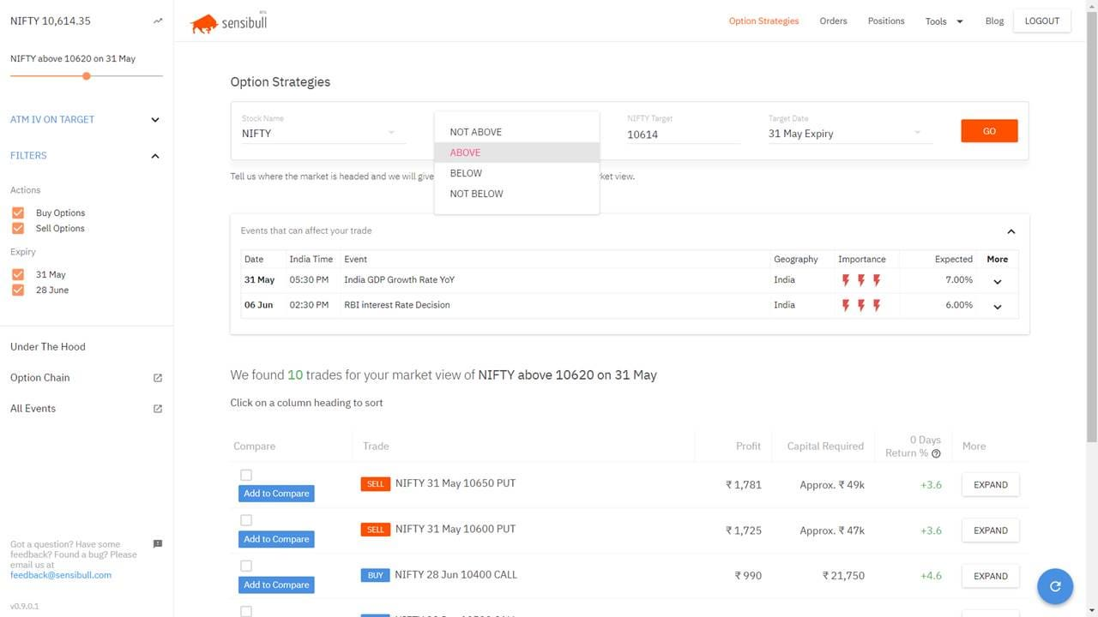
Sensibull
Appendix

Slide 52
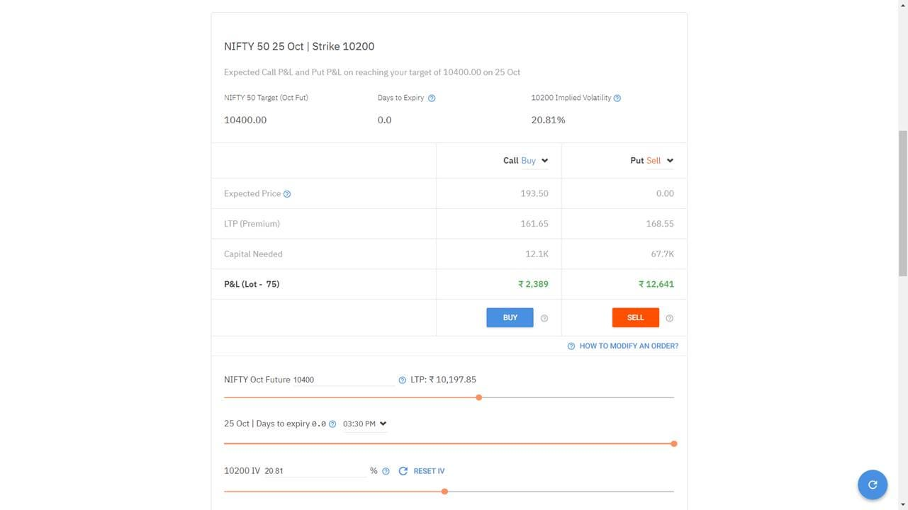
Sensibull
Appendix

Slide 53
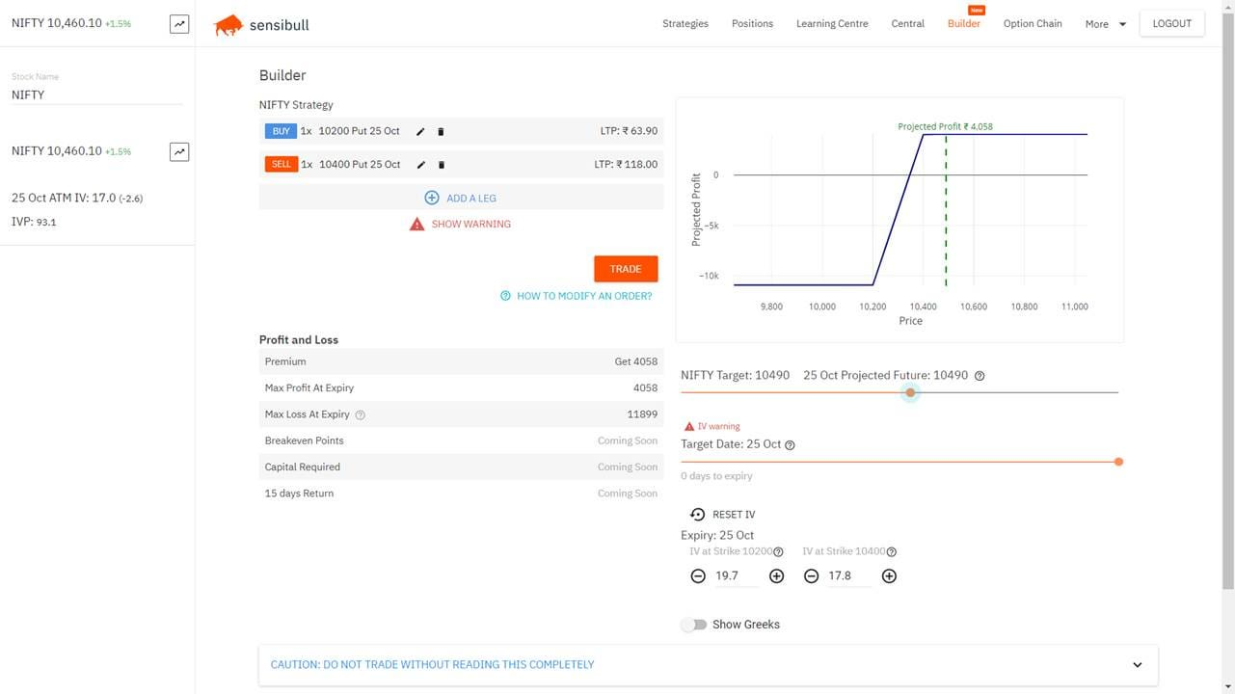
Sensibull
Appendix

Slide 54
International broker firms’ Products ideas

Slide 55
1. Double trap Trail Order:
Principle:
Customer places overnight order with anticipation that market might move in either Upward or Downward Direction.
The Order is taken with a gap of X Rupees offset value.(Say INR 3 Offset on INR 100 Closing Price).
Next day morning if market moves up and it crosses 103. The Sell trailing stop Loss Order will be placed in behalf of customer(Algo).
Next day morning market moves down and is below 97. The Buy trailing stop Loss Order will be placed in behalf of customer(Algo).
Advantage:
Customer do not need to predict whether market will go Up or Down. He just knows that it is an event day(Upwards or Downwards Event)
1st of its kind which will allows retail customer such late decision of Buy/Sell.
We already have trail SLTP Products. So the Execution will happen at the best trail price.
Can prove a revenue product for Big event day. (Election, Budget, US Fed rate, RBI monitory policy, Brexit etc)

Slide 56
1. Double trap Trail Order:
Downside:
We will have one more kind of Algo Order for maintenance.
Target Audience:
A large set of customers does not know whether the market will go up or down on next day election result day or Budget day.
They wanted to enter the market. But it became too late when they entered next day, hence dropped the idea.
These customers want system assistance. May be Algo assistance.
As per our Primary survey we found 50% of customers very exciting. (Sample size 8), We can do a better sampling.

Slide 57
Illustration 1:
LTP: 11,340 SLTP: 11,330
Customer has placed an order with offset of Rs. 10 on closing price of Rs. 11,300.
LTP: 11,330 SLTP: 11,320
LTP: 11,330
LTP: 11,320
SLTP: 11,310
SLTP Triggered
Case 1:
Market moves up by 10 points
Trail
SELL
LTP: 11,310 SLTP: 11,300
LTP: 11,300
Order Triggered
Case 2:
Market moves down by 10 points
LTP: 11,290 SLTP: 11,300
BUY
Trail
LTP: 11,280 SLTP: 11,290
SLTP Triggered
LTP: 11,270 SLTP: 11,280
LTP: 11,270
LTP: 11,260 SLTP: 11,270

Slide 58
2. Max Profit Min Loss
Principle:
Customer has a Buy position in Futures/Options and He wants to Square off next big event day.
Customer places overnight order with anticipation that market might move in either Upward or Downward Direction.
The Order is taken with a gap of X Rupees offset value.(Say Rs.3 Offset|On Rs.100 Closing Price).
Case I: Next day morning market moves up and it crosses 103. The SELL trailing stop Loss Order will be placed in behalf of customer(Algo)
Case II: Next day morning market moves down below 97. The SELL Normal Order will be placed @ Market/Limit in behalf of customer(Algo)
Advantage:
Customer do not need predict whether market will go Up or Down. He just knows that it is an event day(Upwards or Downwards Event).
His position will be squared off either at best possible profit. Or a Minimal loss.
We already have trail SLTP Product. So the the Execution will happen at the best trail price.
Can be a good Square Off Product for Big event day, or even on a Normal day. (Election, Budget, US Fed rate, Brexit etc). Help customer in profit making.

Slide 59
2. Max Profit Min Loss
Downside:
We will have one more kind of Algo Order for maintenance
Target Audience:
A large set of customers do not know whether the market will go up or down on next day election result day or Budget day.
They wanted to enter the market. But it became too late when they entered next day, hence dropped the idea.
These customers want system assistance…May be Algo assistance.

Slide 60
Illustration 2:
LTP: 11,340 SLTP: 11,330
Customer has BUY position in Futures/ Options: LTP: 11,300 SLTP: 11,290
Limit Price: 11, 280
LTP: 11,330 SLTP: 11,320
LTP: 11,330
LTP: 11,320
SLTP: 11,310
SLTP Triggered
Trail
LTP: 11,310 SLTP: 11,300
SELL
Sell Order Triggered
LTP: 11,300
SELL
SLTP Triggered
LTP: 11,290

Slide 61
Illustration 2:
Customer has SELL position in Futures/ Options: LTP: 11,300 SLTP: 11,310
Limit Price: 11,320
LTP: 11,310
BUY
SLTP Triggered
LTP: 11,300
BUY
Buy Order Triggered
LTP: 11,290 SLTP: 11,300
Trail
LTP: 11,280 SLTP: 11,290
SLTP Triggered
LTP: 11,270 SLTP: 11,280
LTP: 11,270
LTP: 11,260 SLTP: 11,270

Slide 62
3. Probability of Profit:
Pop w/ Selling Options:
When we sell options, we sell them at strikes that are ATM (where the stock price is trading) or OTM (at a better price than where the stock price is trading).
When selling an option, the stock price can stay the same, go in our favor, or go against us just a bit and we’ll still be profitable at expiration. The ability to make money in multiple ways results in a higher probability of success overall.
When selling options, we collect a credit, which is cash. This credit can be used as a buffer against losses on our position, which grants us an even higher probability of success.
Because our BEP is directly related to our POP, and this breakeven is improved by selling premium, we can consistently improve our POP with premium selling strategies.
Pop w/ Buying Options:
Buying a naked option is the worse thing we can do for our breakeven, as we don’t hedge the cost of the option in any way.
Our goal when buying spreads is to obtain a BEP that is very close to where the stock price is trading now, or just a bit better in an ideal setup. Doing so ensures that we have around a 50% POP or just a bit better.

Slide 63
4. Relative Order: Powerful Trigger Application
Principle:
Stock A is placed or Intimated to place as alert based on various relative milestones.
(Target Stock – NIFTY) > 20 Points
OR (Target Stock – NIFTY) > x% of NIFTY
We can put Open Interest or Volume or Any Greek also as relative condition.
We already have SMS trigger application, we can build over it.
Advantage:
More Options to customers for Relative placement.
Near to Algo orders, at least we can start with trigger.
We can provide free of cost value added service.
We can build a powerful trigger application as a substitute of Algo.
Downside:
Alerts framework might need effort at our end.
Incase Algo, we will have one more Algo to maintain.
Target Audience:
All ICICI Direct Customer.

Slide 64
3. Probability of Profit:
Principle:
Display the probability of Profit on an options trade using Black Scholes Model.
Input: Stock (or futures) Price, Strike Price, days to expiry, and IV and your average traded price for the option.
Advantage:
It helps you with decision making. If an option you bought has a very low PoP (<15%), then it is unwise to hold on to it. You will almost always lose the entire premium. In such cases, it is wise to exit such OTM options, or exit and enter a more ATM option.
Value added Analytical tool: Risk Checker
Downside:
This number does not take into account any technical or fundamental analysis. A high or low probability of profit is not a recommendation of any kind.
Cannot use it standalone basis
Target Audience:
All ICICI Direct Customers

Slide 65
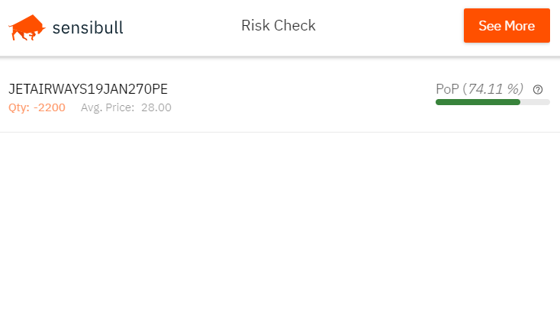
3. Probability of Profit:

Slide 66
3. Probability of Profit:
Pop w/ Selling Options:
When we sell options, we sell them at strikes that are ATM (where the stock price is trading) or OTM (at a better price than where the stock price is trading).
When selling an option, the stock price can stay the same, go in our favor, or go against us just a bit and we’ll still be profitable at expiration. The ability to make money in multiple ways results in a higher probability of success overall.
When selling options, we collect a credit, which is cash. This credit can be used as a buffer against losses on our position, which grants us an even higher probability of success.
Because our BEP is directly related to our POP, and this breakeven is improved by selling premium, we can consistently improve our POP with premium selling strategies.
Pop w/ Buying Options:
Buying a naked option is the worse thing we can do for our breakeven, as we don’t hedge the cost of the option in any way.
Our goal when buying spreads is to obtain a BEP that is very close to where the stock price is trading now, or just a bit better in an ideal setup. Doing so ensures that we have around a 50% POP or just a bit better.

Slide 67
Appendix

Slide 68
Micro Investing - Appendix

Slide 69

Saveabhi

Slide 71
Personal Finance Management - Appendix

Slide 72

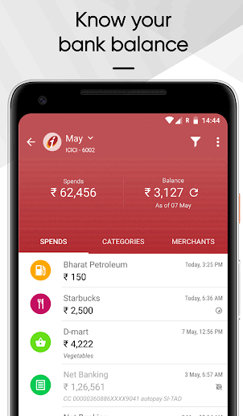
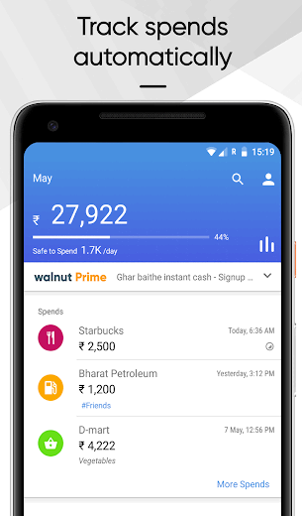
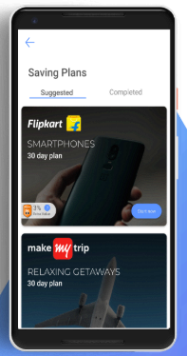
Personal Finance Apps
5 Million + Downloads
1 Lac+ Downloads on Play Store
Flexi & Fixed Saving Plans to save by transferring the savings amount to Wizely App
The amount can be spent on the Merchant partners like Flipkart, MakeMyTrip with deep discounts – which in turn is more than a FD interest rate
All bank’s Money Manager, Track Bank balance & Cards
Walnut analyses your SMS inbox on phone and detects important information like your spends, bills and even your train tickets, facilitates UPI transfers
SPLIT expenses with friends - The slickest bill split experience!

Slide 73


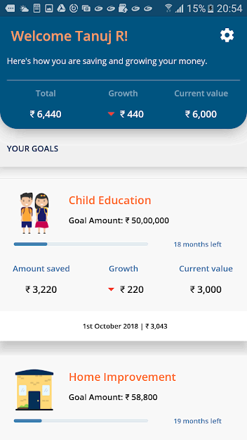
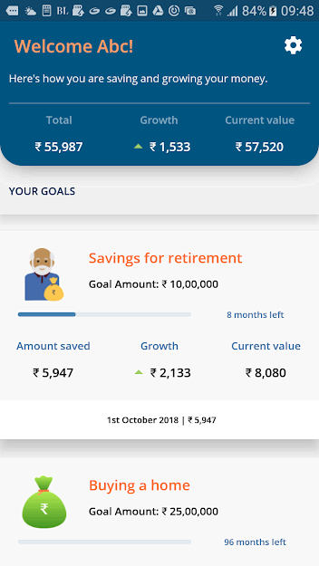
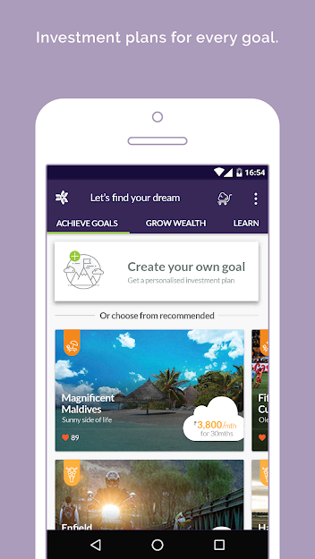
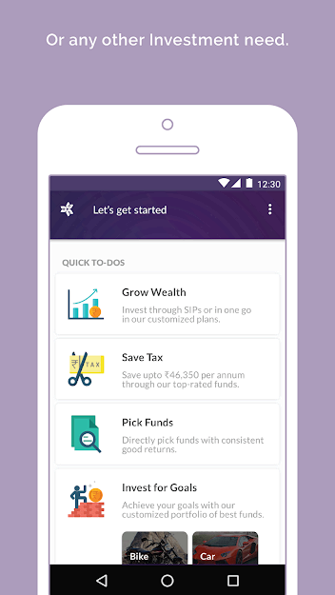
Personal Finance Apps
Personal Finance App making people habitual to save for better life goals
Also provides Digital Lending facilities on Tap
Personal Finance cum Goal Planner cum Investment App
Online KYC, Mutual Funds & Insurance
1 Lac + Downloads

Slide 74
Investment Games- Appendix

Slide 75
Rules
One person can place only one bid per index(mobile number being the unique identifier) during the day on Nifty 50 , Bank Nifty, Nifty IT etc
The bid is to be placed before 9 a.m. on every trading day
The results will be announced using leaderboards in app / website
Use of instruments other than stocks is not allowed ( i.e. DVRs, derivatives, cash etc.)
Alternatively we can disable other instruments from our end / allow investing only in a select set of stocks
The person has to invest in a minimum of 10 and can invest in a maximum of 10 stocks
Each contestant will be allocated virtual money / tokens / chips worth INR 10 lakhs
First bet is for free. Subsequent bets are charged at Rs 50
We’ll have a cap on the number of participants on each window

Slide 76
Revenue Estimate
Number of Demat Account holders have been taken as a proxy for total market size
Revenues have been calculated using this number

Slide 77


Wireframes
Login
User Id / Email
joshiashwini215@gmail.com
Password
********
LOGIN
Forgot Password?

Slide 78
Wireframes
Choose Index
Select Index to place your bet
Nifty 50
Bank Nifty
Sensex 30

Slide 79
Wireframes
Portfolio
Select Stocks to create portfolio
ICICI Bank
Enter Value
150000
Add to portfolio
Virtual Balance Remaining: 1000000
Your portfolio

Slide 80
Wireframes
Portfolio
Select Stocks to create portfolio
Maruti Suzuki
Enter Value
100000
Add to portfolio
Virtual Balance Remaining: 850000
Your portfolio
Stock | Value
ICICI Bank | 150000
Action
Remove
Add 9 more stocks to complete your portfolio
Publish Portfolio

Slide 81
Wireframes
Portfolio
Select Stocks to create portfolio
Enter Value
Add to portfolio
Virtual Balance Remaining: 750000
Your portfolio
Stock | Value
ICICI Bank | 150000
Maruti Suzuki | 100000
Action
Remove
Remove
Add 8 more stocks to complete your portfolio
Publish Portfolio

Slide 82
Wireframes
Portfolio
Select Stocks to create portfolio
Cannot add more stocks
Enter Value
0000
Add to portfolio
Virtual Balance Remaining: 0
Your portfolio
Stock | Value
ICICI Bank | 150000
Maruti Suzuki | 100000
Reliance | 200000
Action
Remove
Remove
Remove
Portfolio complete
Publish Portfolio

Slide 83
Wireframes
Payment
Select payment options
ICICI BANK
A/C No. *******5020
BHIM UPI
UPI ID 821*****20@icici
PAY

Slide 84
Wireframes
Home
You have entered the contest!!
All the Best!!

Slide 85
Wireframes
Home
Your portfolio
Stock | Value
ICICI Bank | 151290 | + 0.86%
Maruti Suzuki | 99500 | - 0.50%
Reliance | 203340 | + 1.67%
TCS | 101080 | + 1.08%
HDFC Bank | 50330 | + 0.66%
HUL | 202240 | + 1.12%
ITC | 25080 | + 0.32%
State Bank | 50230 | + 0.46%
Bajaj Auto | 24955 | - 0.18%
Yes Bank | 98500 | - 1.50%
Total | 1006545 | + 0.65%

Slide 86
Wireframes
Menu
Home
View Portfolio
Create More Portfolios
View Contest
Rules
View Performance
Referral
Learn about stock market
Your portfolio
Stock | Value
ICICI Bank | 151290 | + 0.86%
Maruti Suzuki | 99500 | - 0.50%
Reliance | 203340 | + 1.67%
TCS | 101080 | + 1.08%
HDFC Bank | 50330 | + 0.66%
HUL | 202240 | + 1.12%
ITC | 25080 | + 0.32%
State Bank | 50230 | + 0.46%
Bajaj Auto | 24955 | - 0.18%
Yes Bank | 98500 | - 1.50%
Total | 1006545 | + 0.65%

Slide 87
Wireframes
Home
Rules :
One person can place only one bid per index(mobile number being the unique identifier) during the day on Nifty 50 , Bank Nifty, Sensex 30 etc.
The bid is to be placed before 9 a.m. on every trading day
The results will be announced using leaderboards in app / website
Use of instruments other than stocks is not allowed ( i.e. DVRs, derivatives, cash etc.)
Alternatively we can disable other instruments from our end / allow investing only in a select set of stocks
The person has to invest in a minimum of 10 and can invest in a maximum of 10 stocks
Each contestant will be allocated virtual money / tokens / chips worth INR 10 lakhs

Slide 88
Accelerator - Appendix

Slide 89
Budget : For one Cohort

Slide 90
Digital Onboarding- Appendix

Slide 91
Comparison Summary
 | Upstox | Motilal Oswal | Zerodha | 5paisa | Angel Broking | IIFL | Aditya Birla Money
e-DIS | e-DIS | e-DIS | Mandatory (Physical) | e-DIS | Mandatory (Physical) | e-DIS | e-DIS
TAT for account opening | 25 mins | 15-20 min | 35 min | 15-20 min | 5 min | 30 min | 15-20 min
TAT for Trading Activation | Within 1 Hr- Trading can be done instantly | Within 30 Min- Trading can be done instantly | Within 12 hrs- Trading can be done from next day | Within 12 hrs- Trading can be done from next day | After 5 Hrs | Within 12 hrs- Trading can be done from next day | Within 3 hrs
IPV | No | No | (Online) Yes- Face and OTP | No | No | Yes, Video Capture | No
End-to-end account opening | Customer driven | Customer Driven | Customer Driven | Customer Driven | Customer Driven | Customer Driven | Customer Driven
Acc opening via mobile app | Yes | Yes | Yes | Yes | Yes | Yes (After you guest login) | Yes (Mobile app redirects A/c opening form to their website)

Slide 92
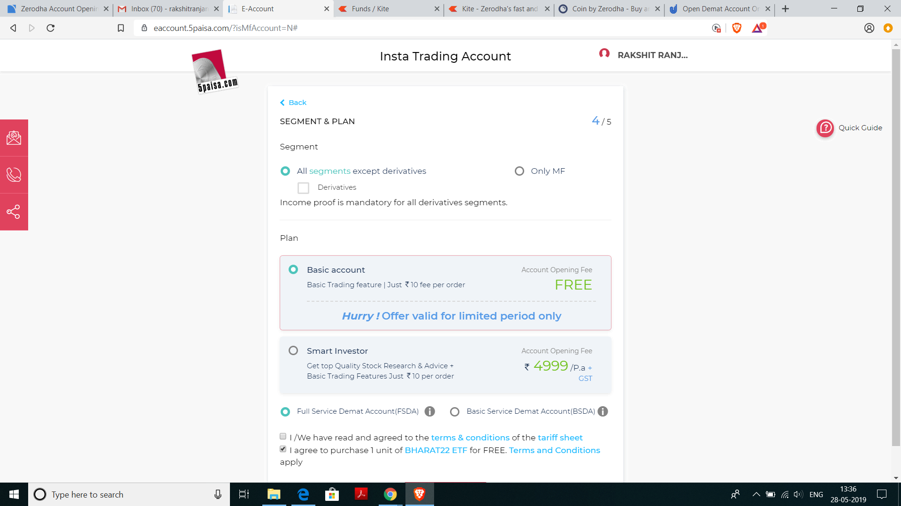
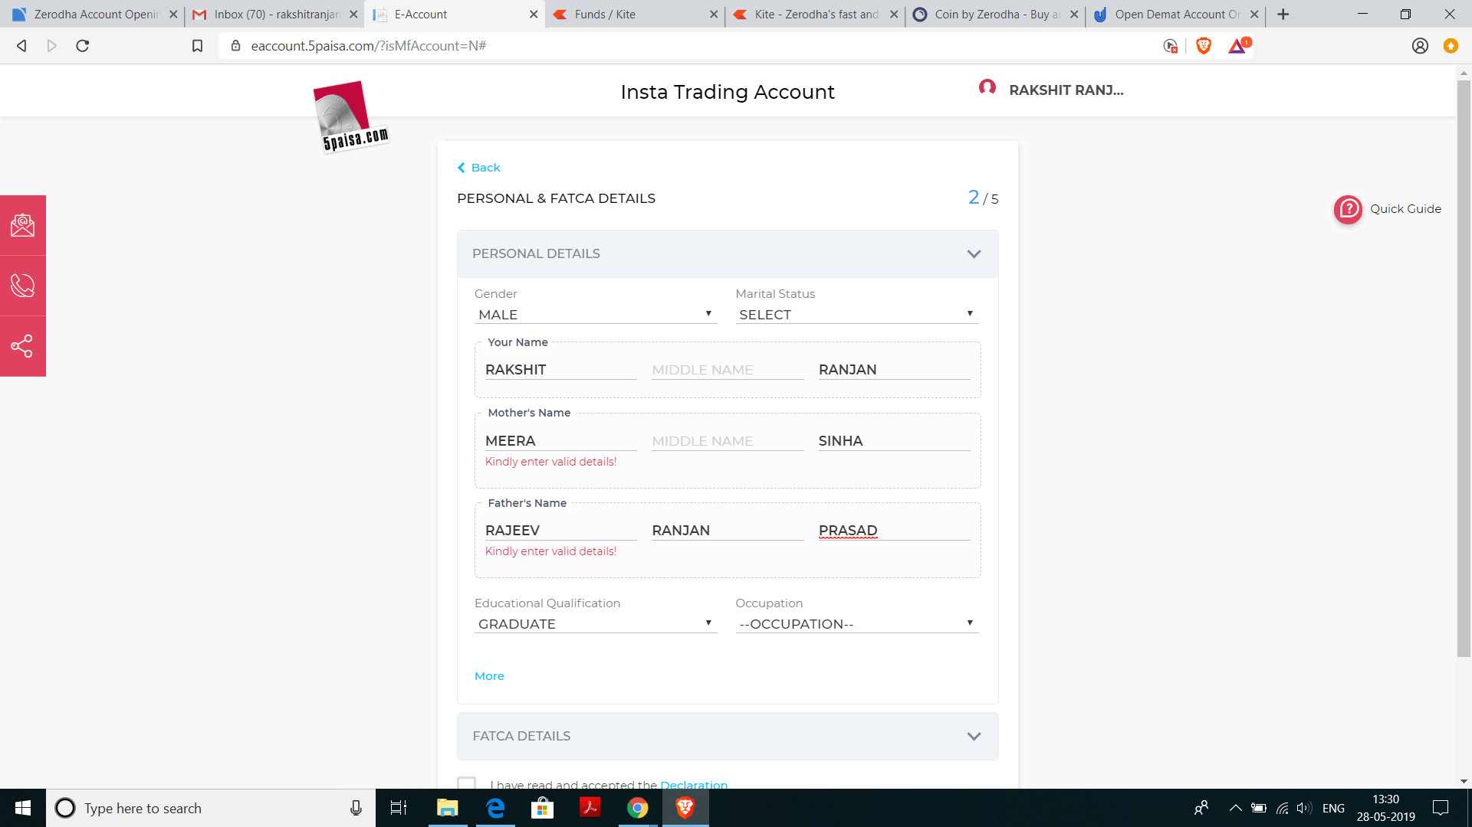
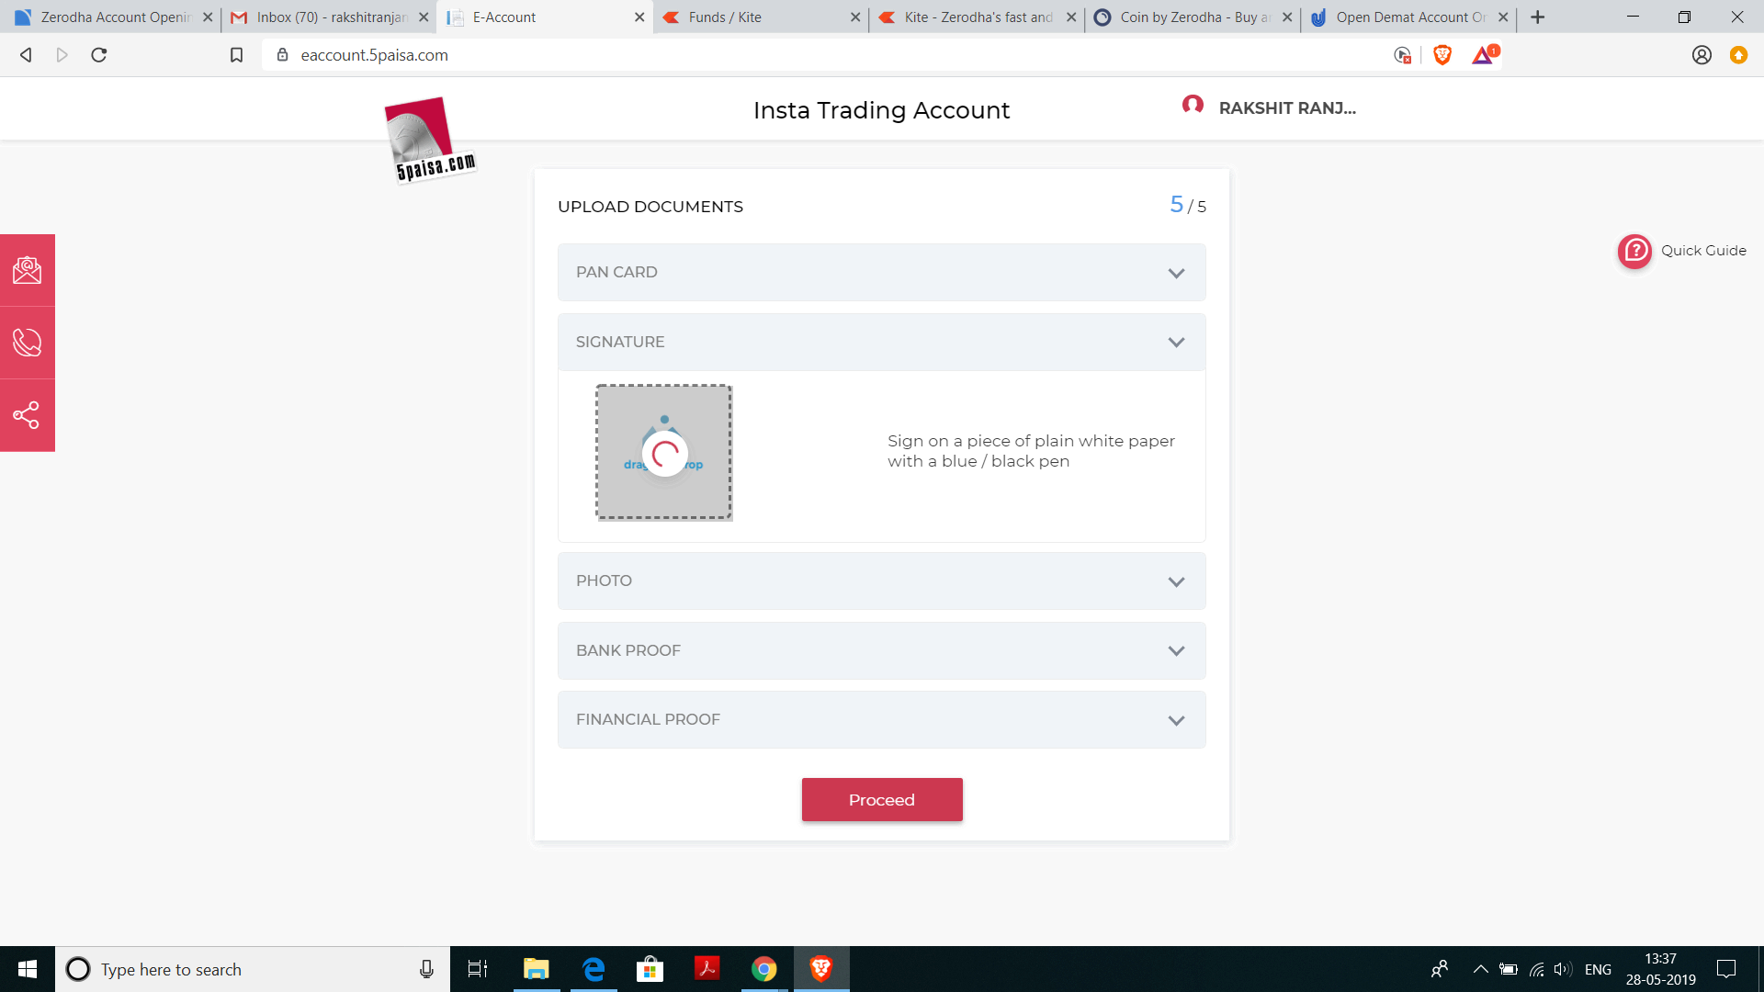
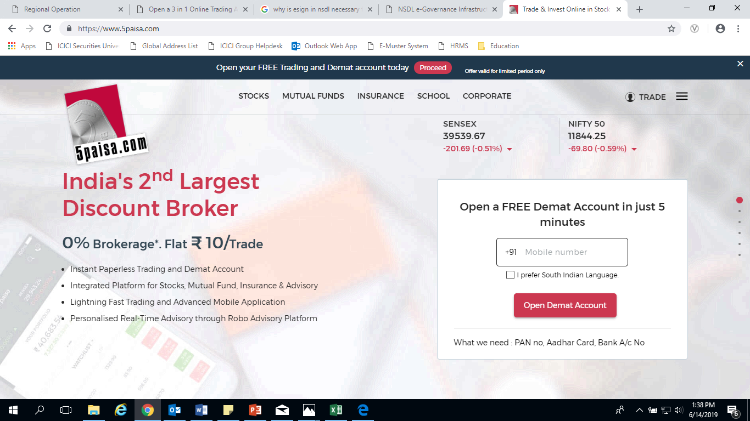
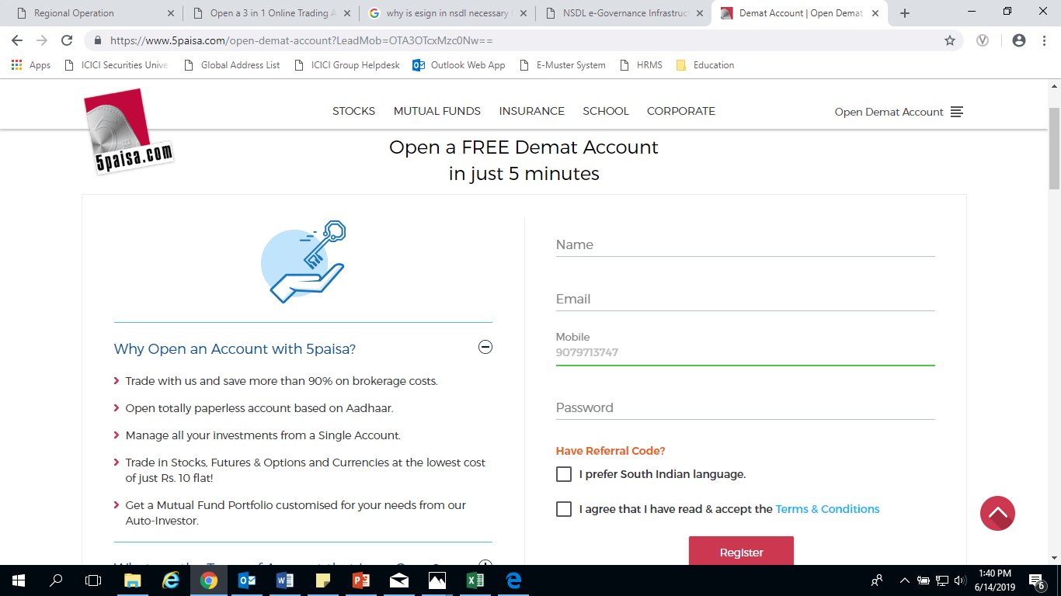
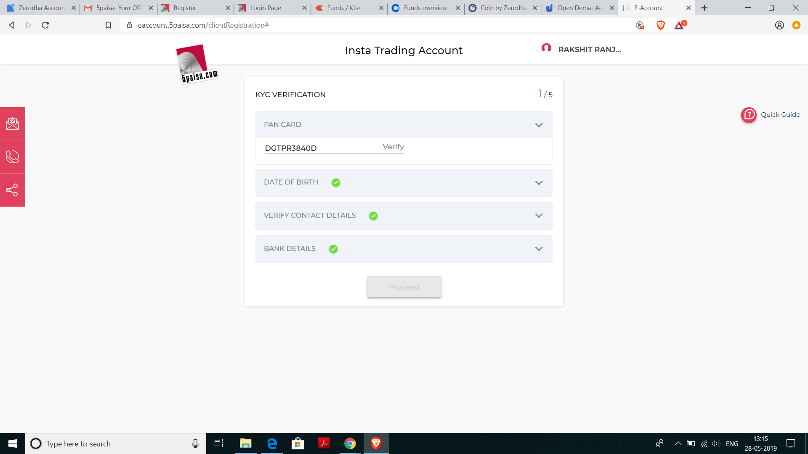
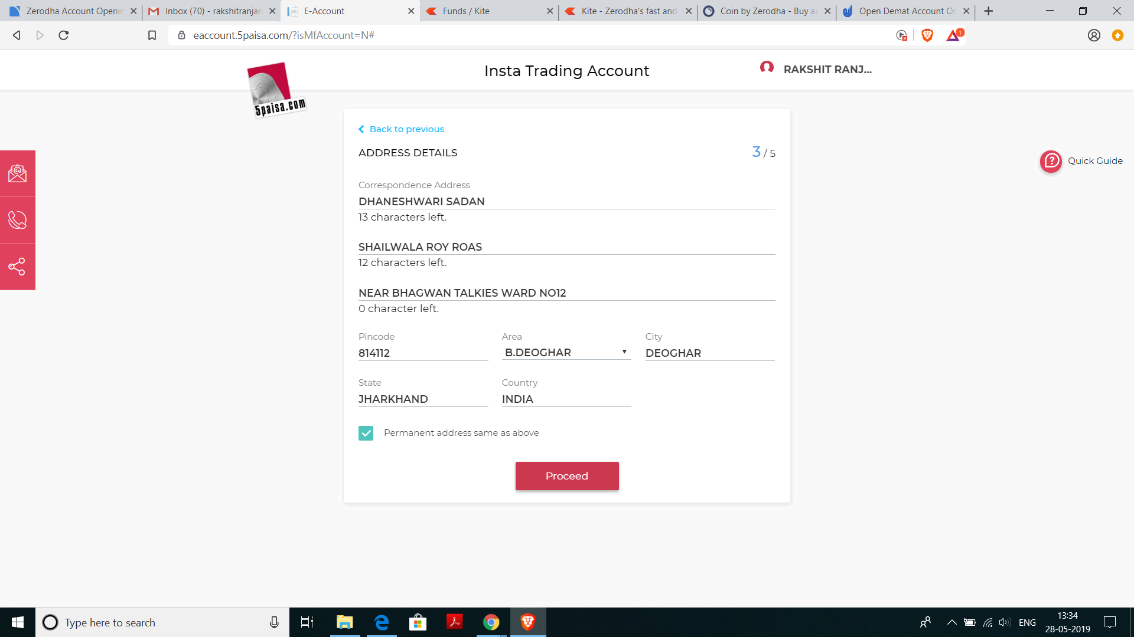
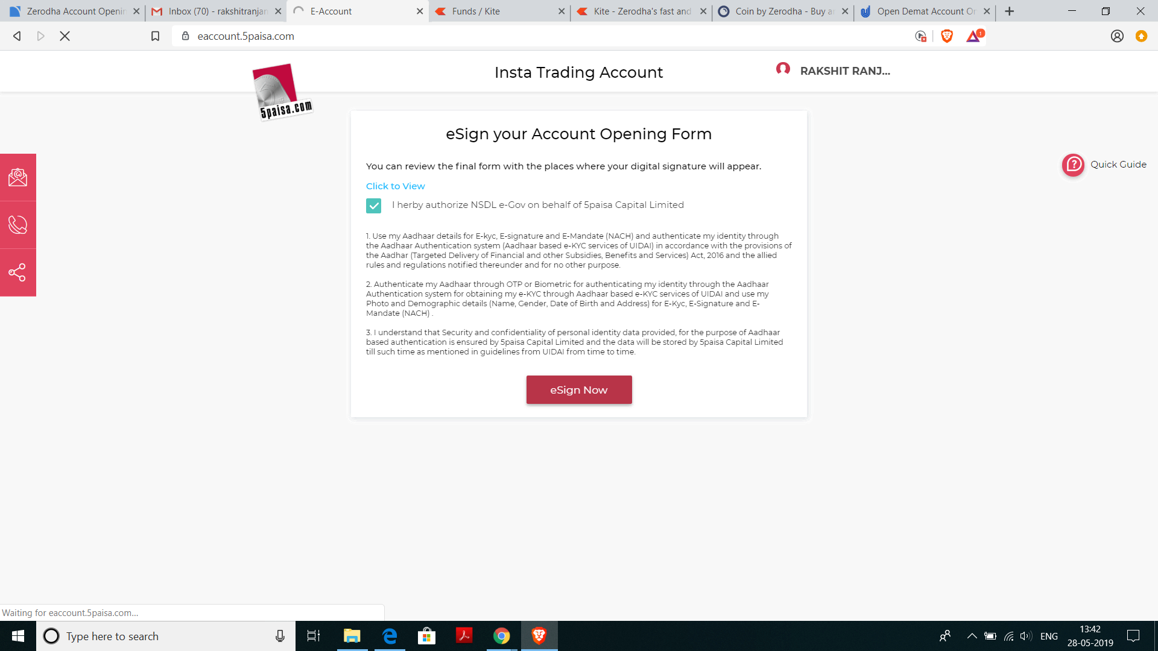
You get a representative to assist you when you sign up.

Slide 93
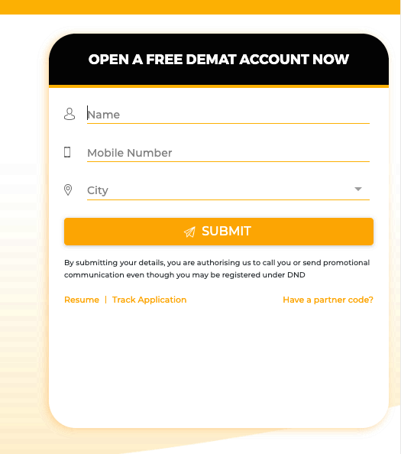
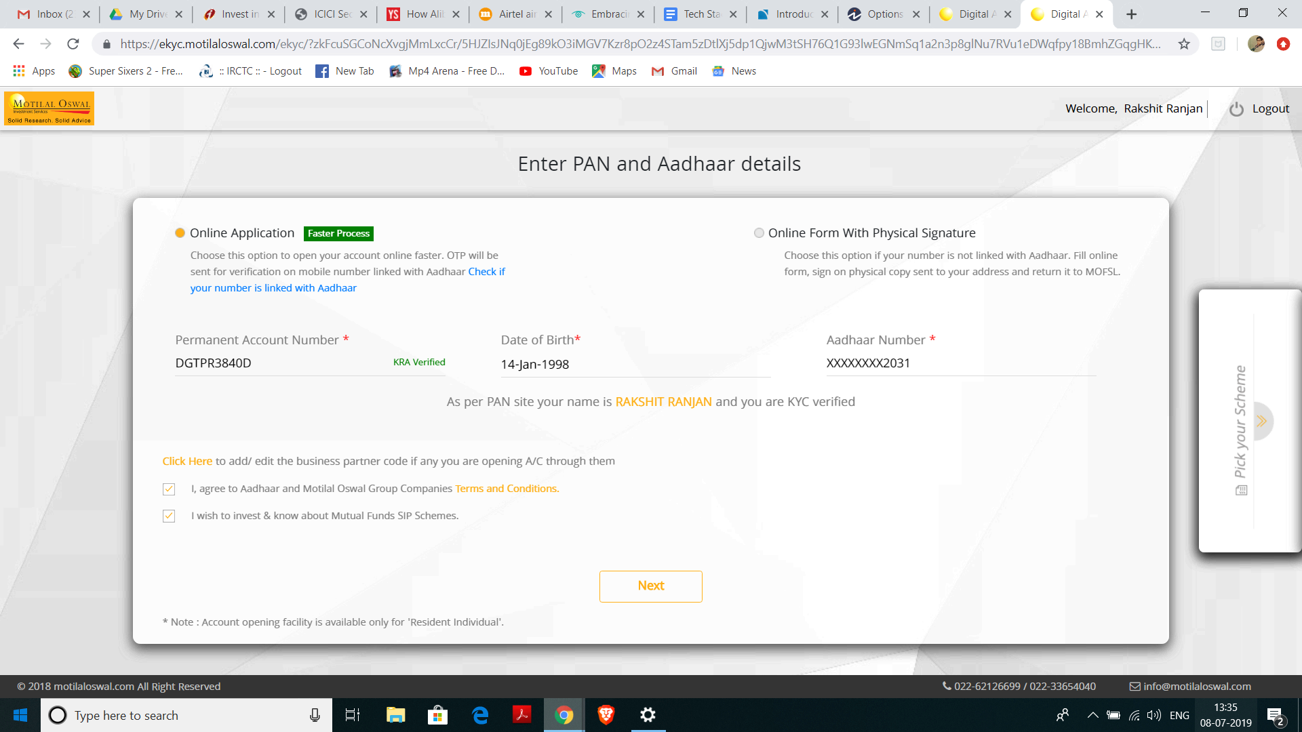
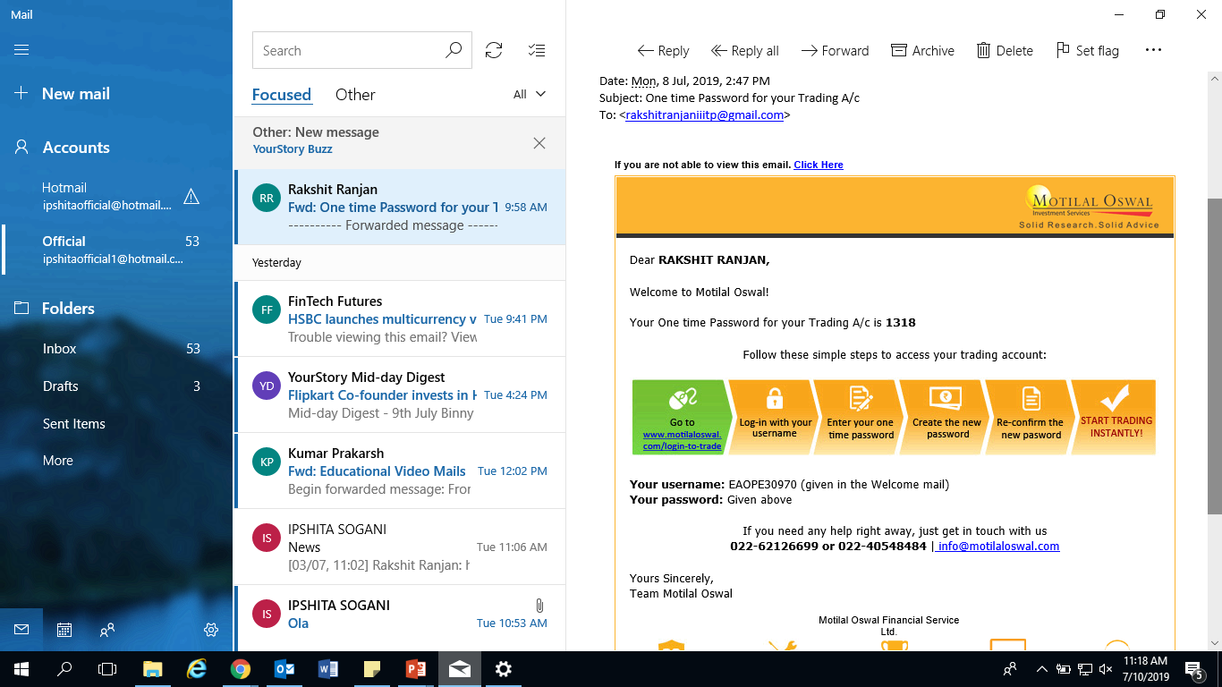
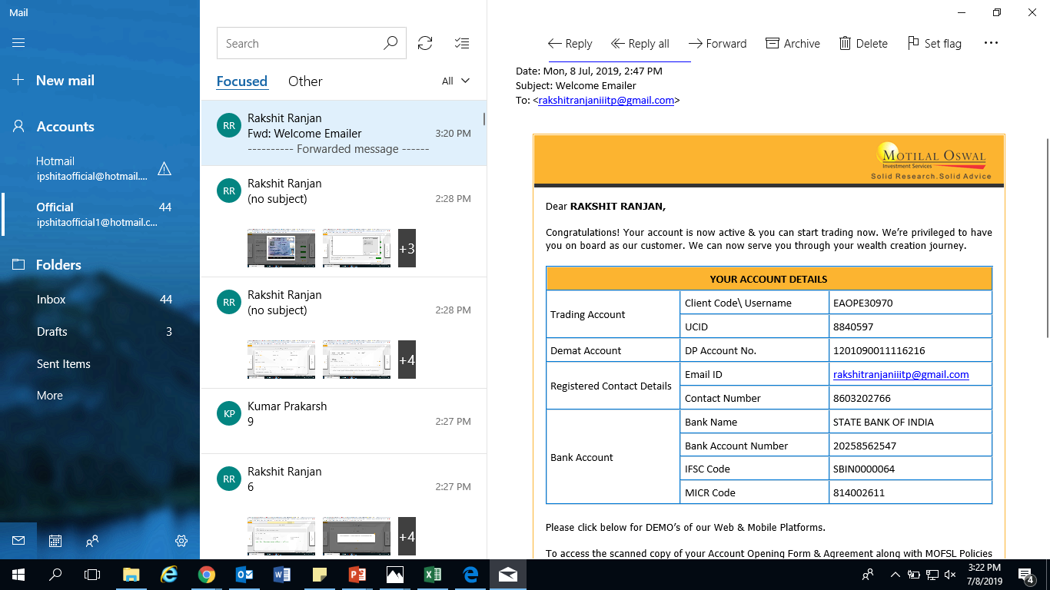
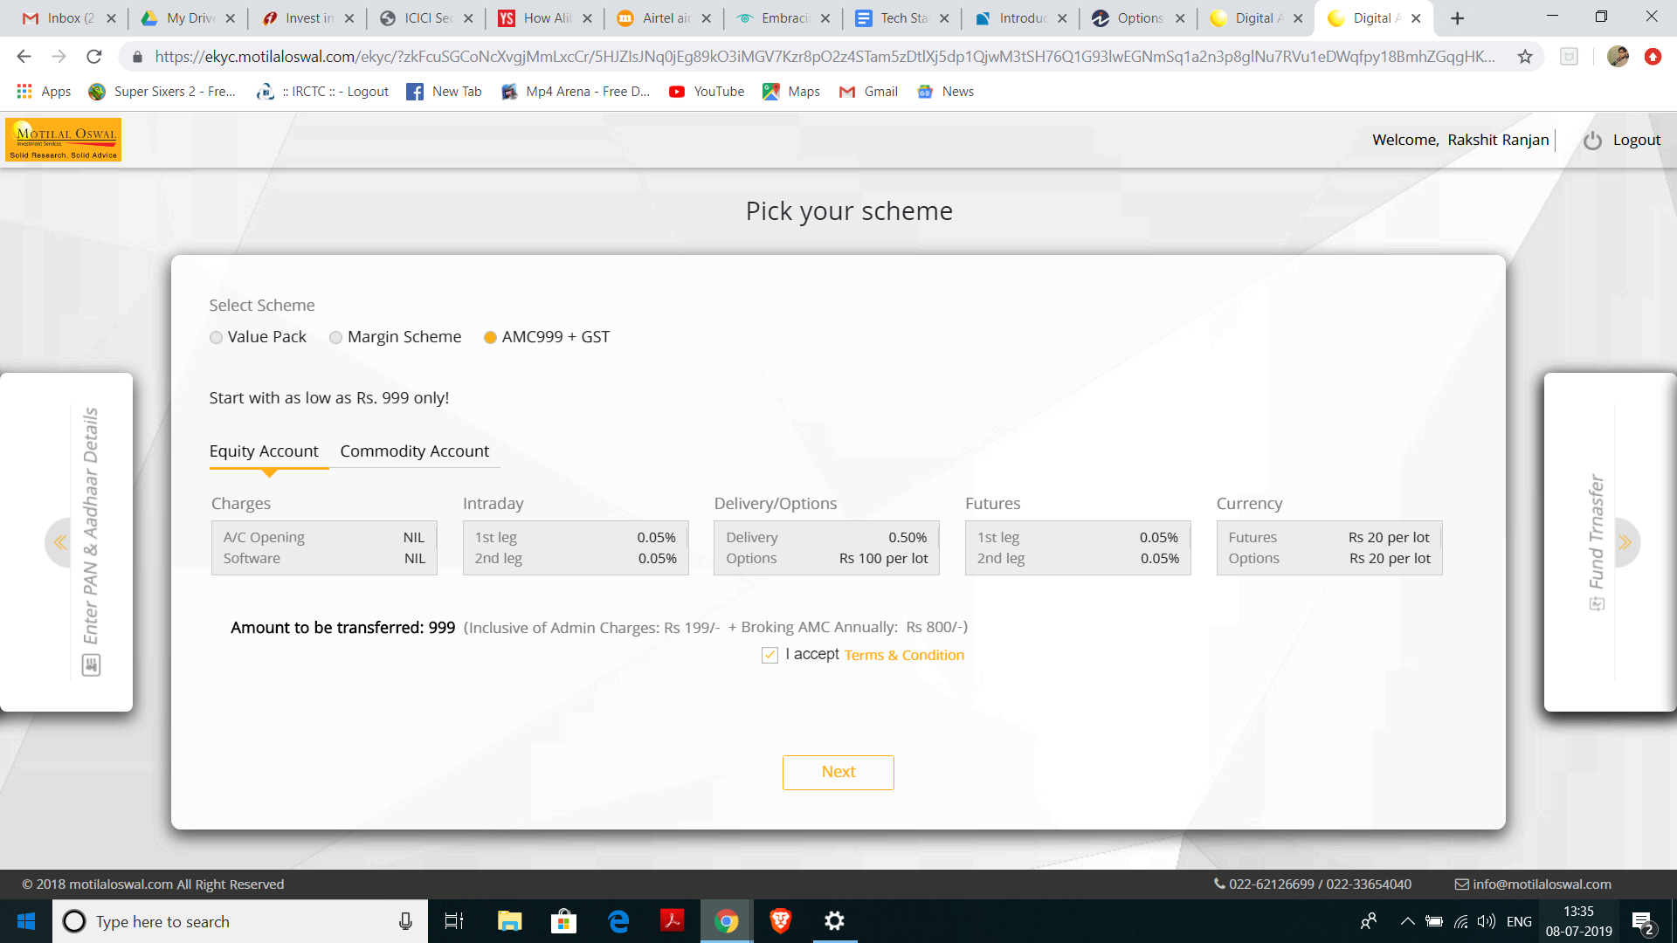
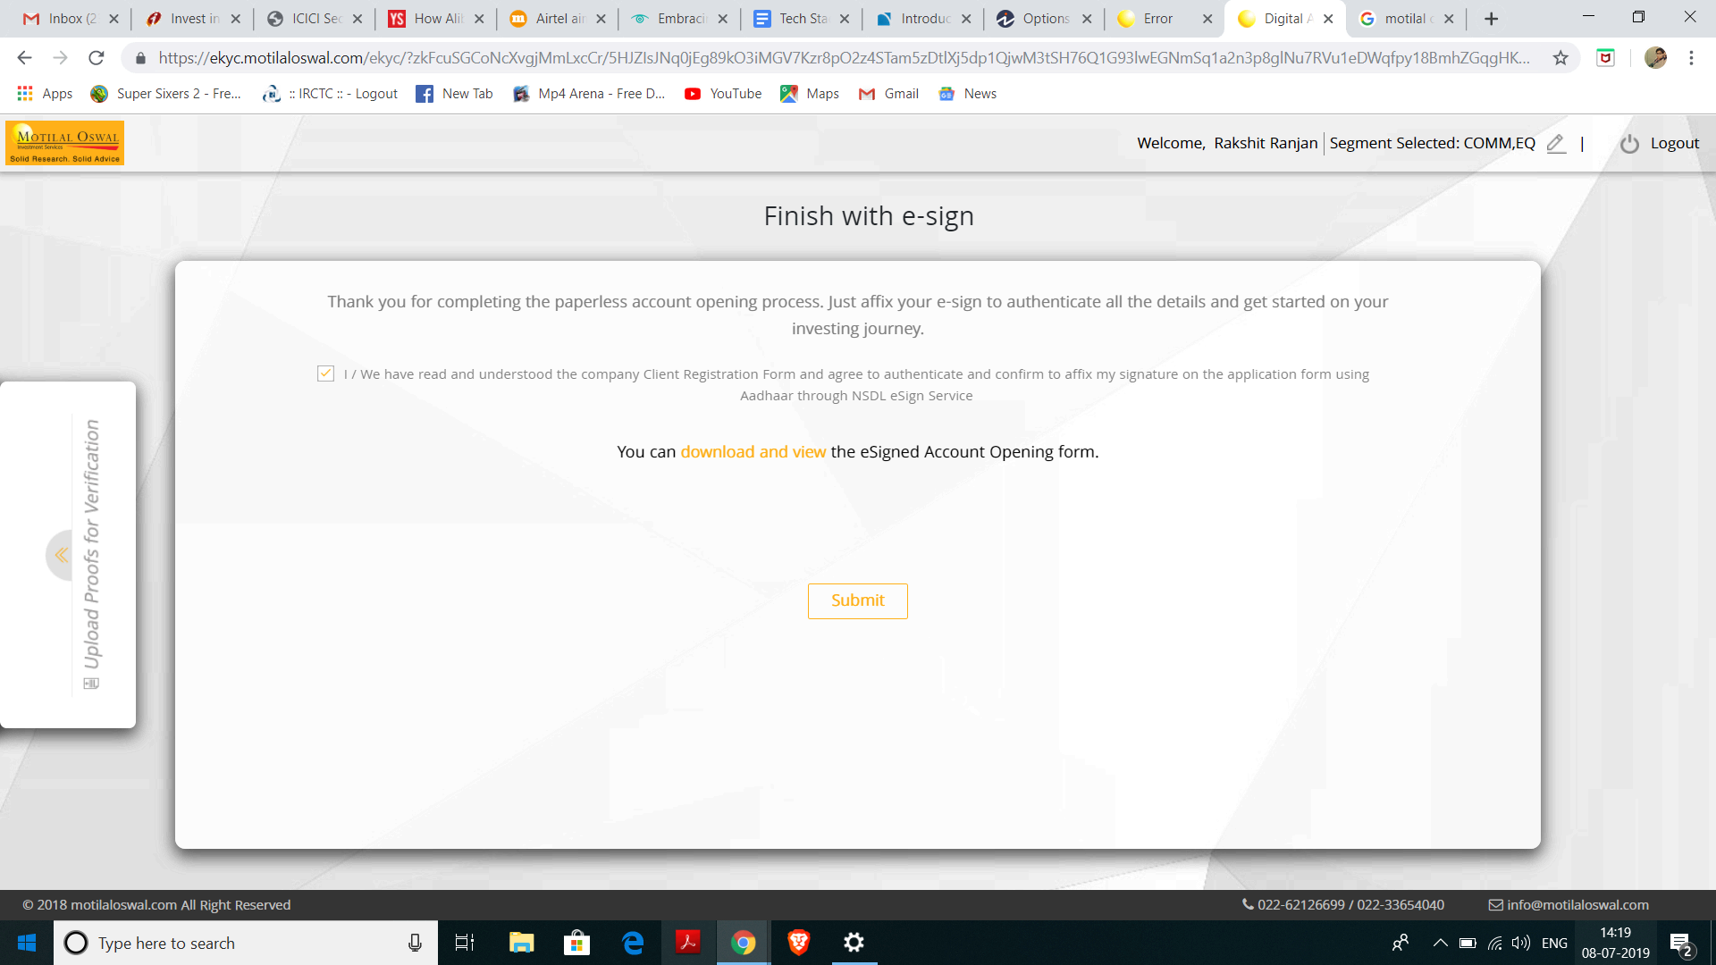
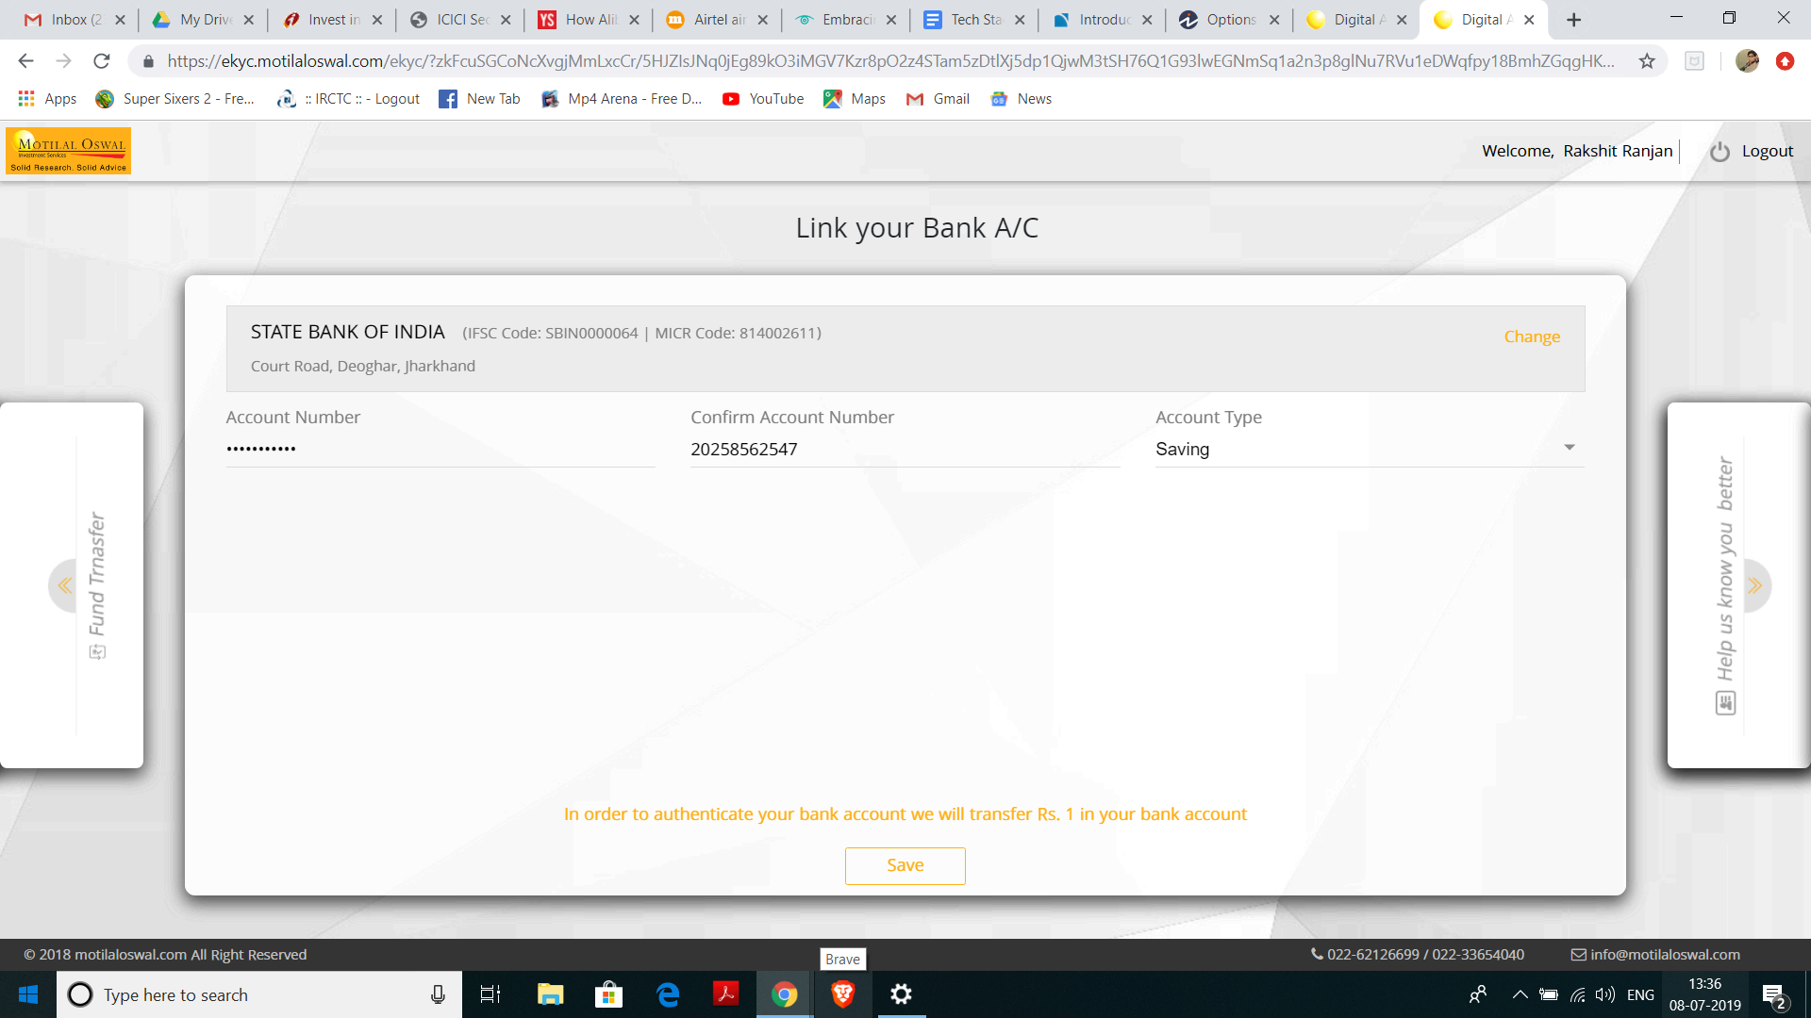
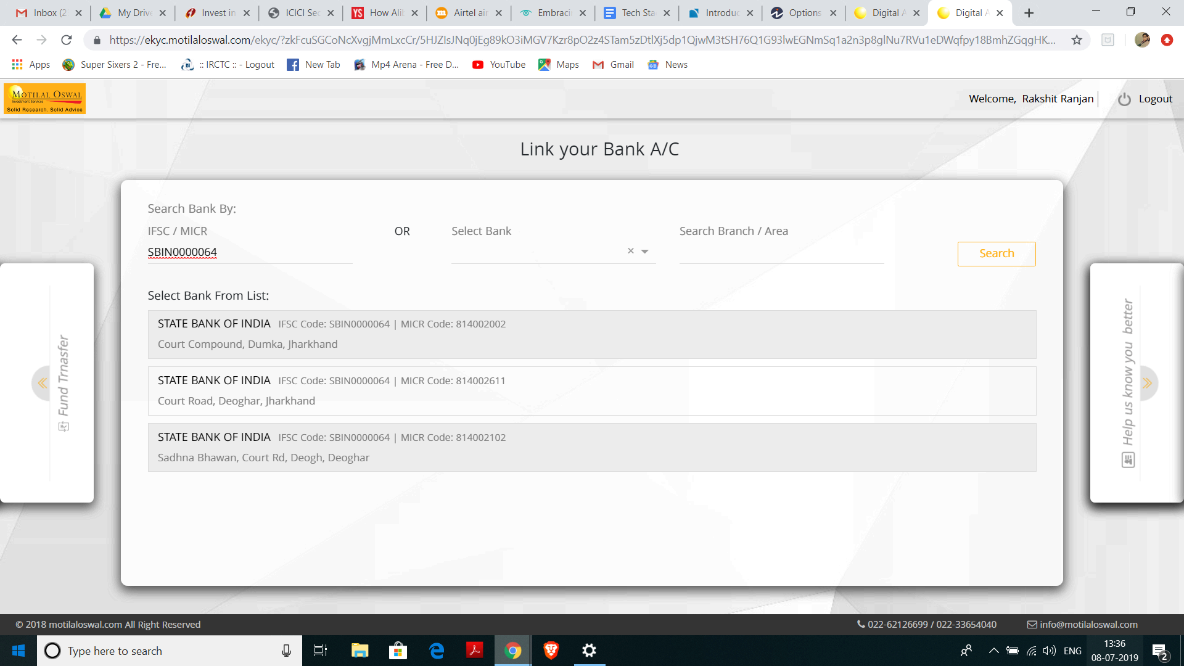
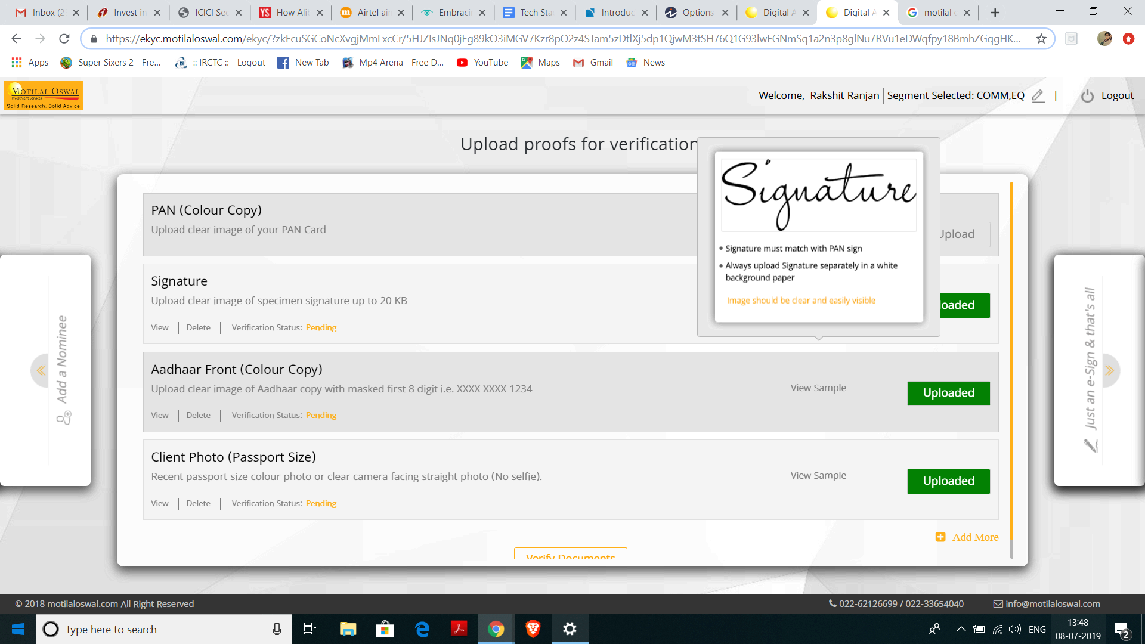
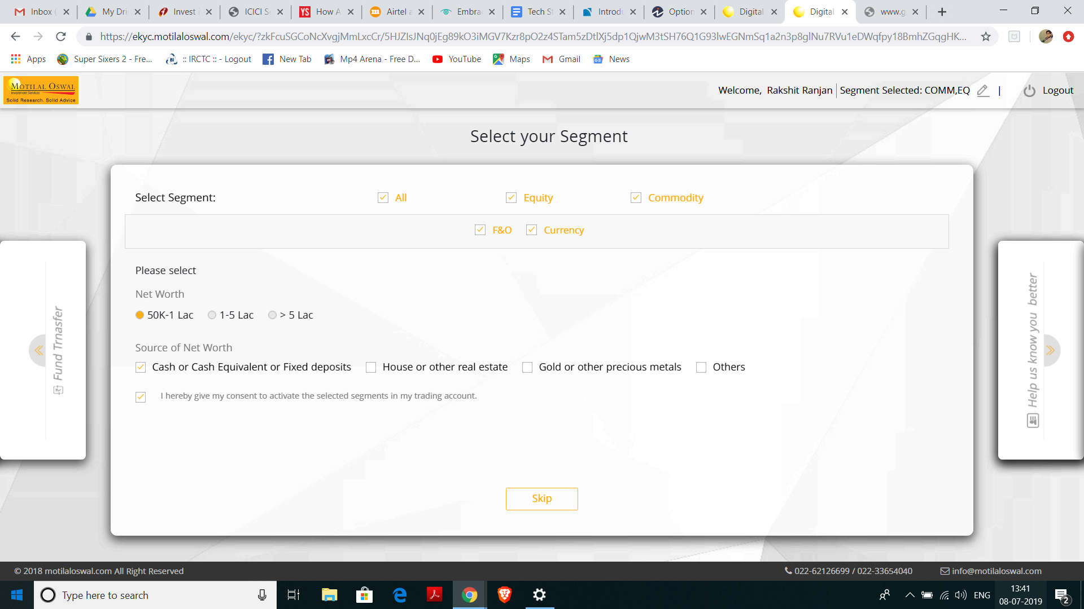
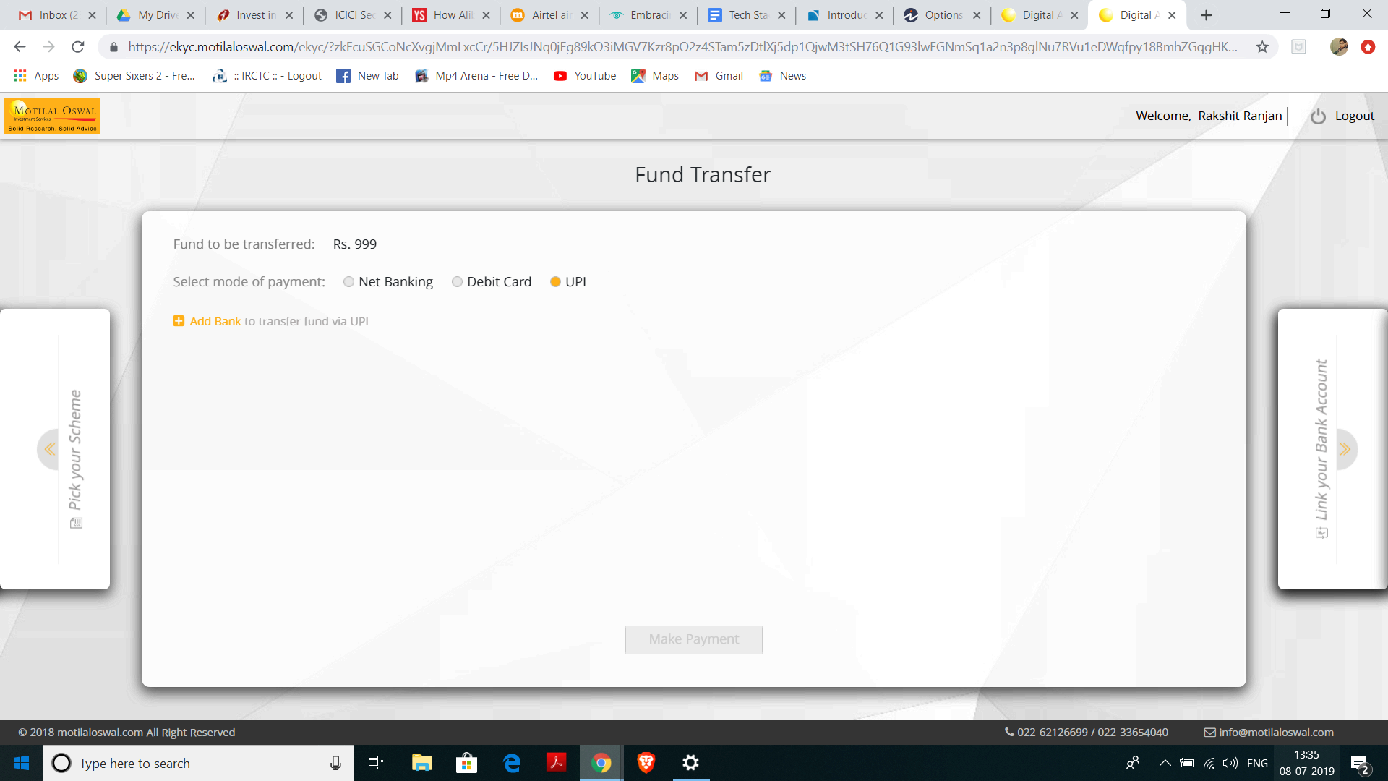
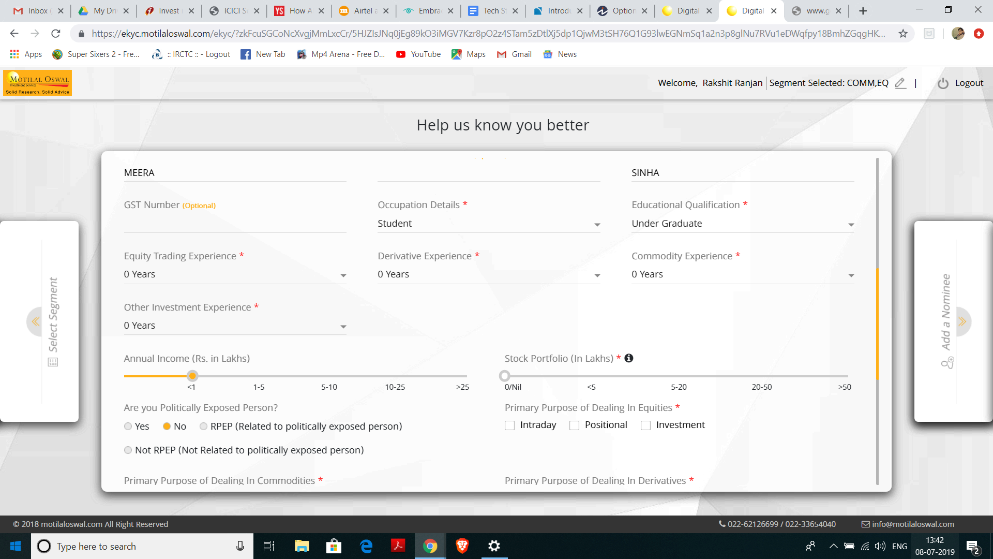
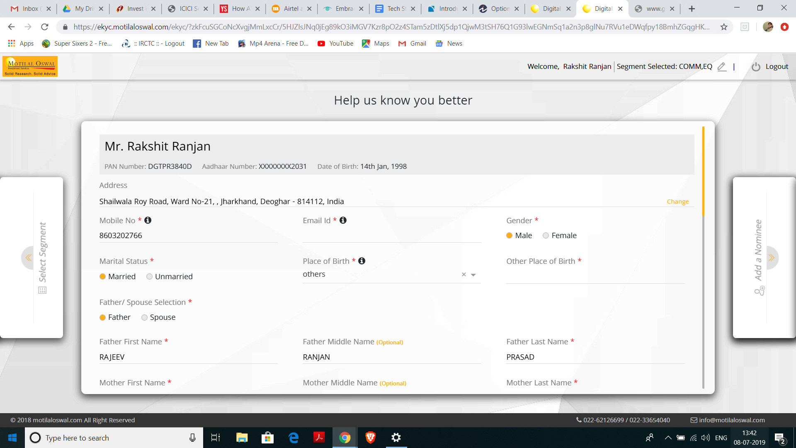
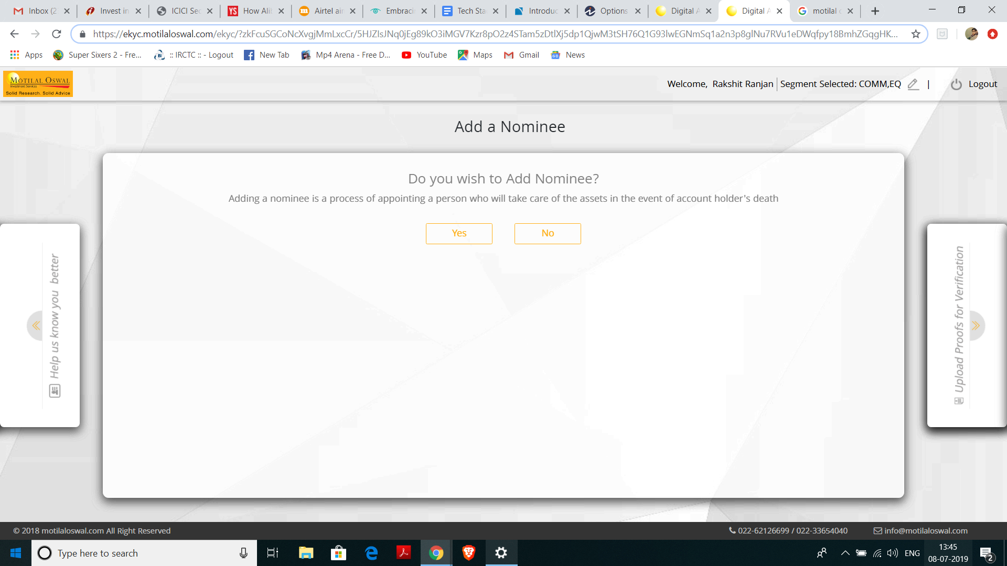
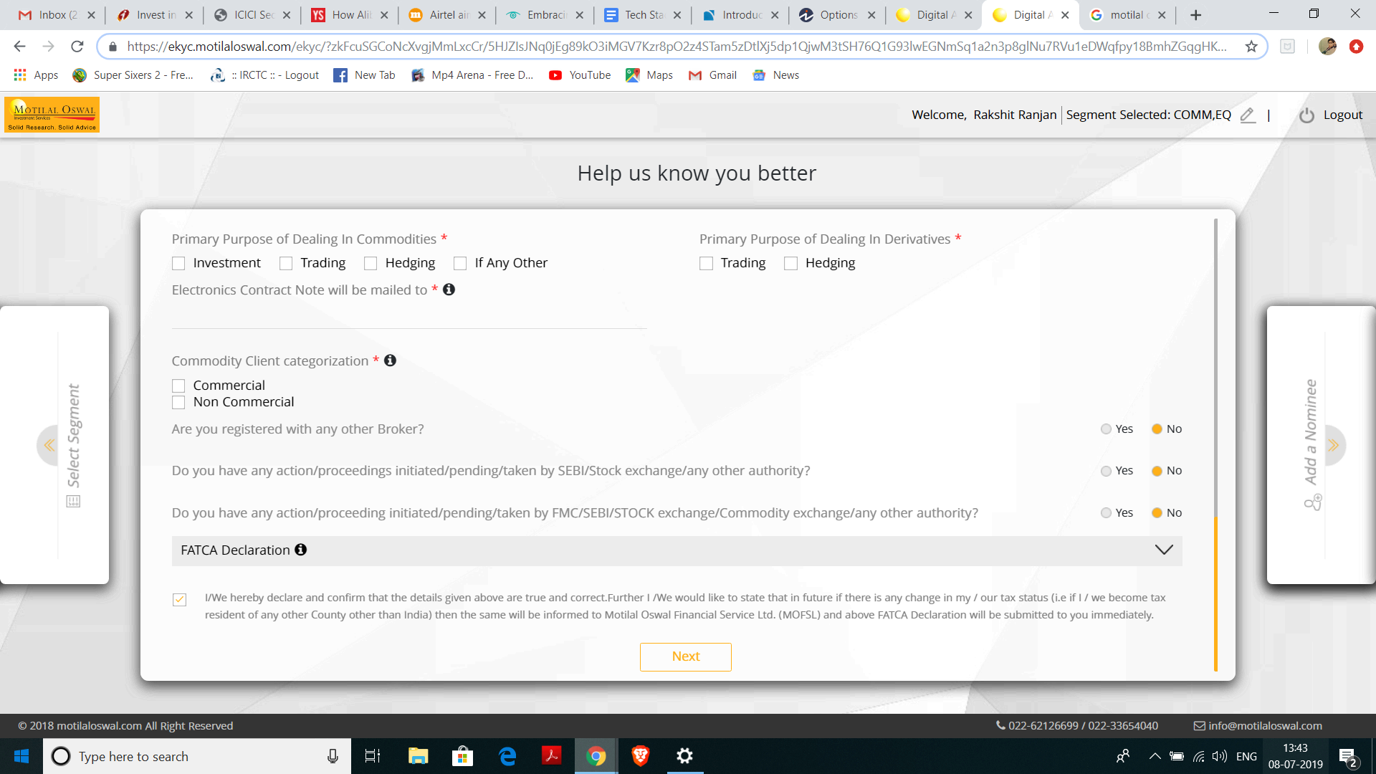
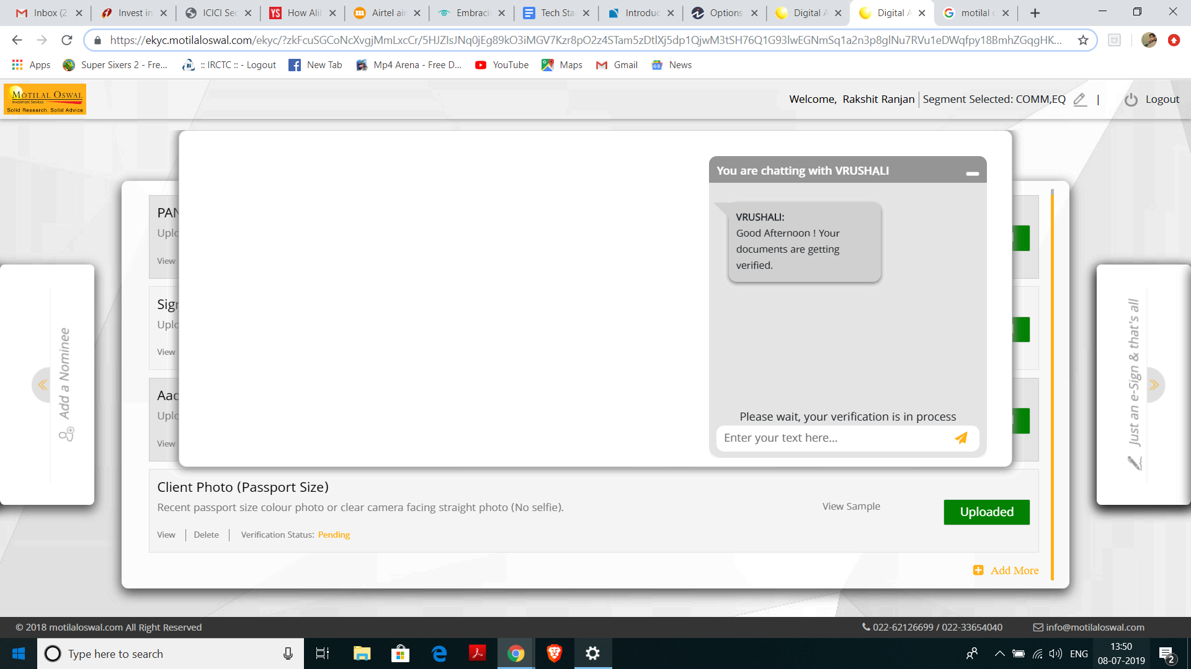
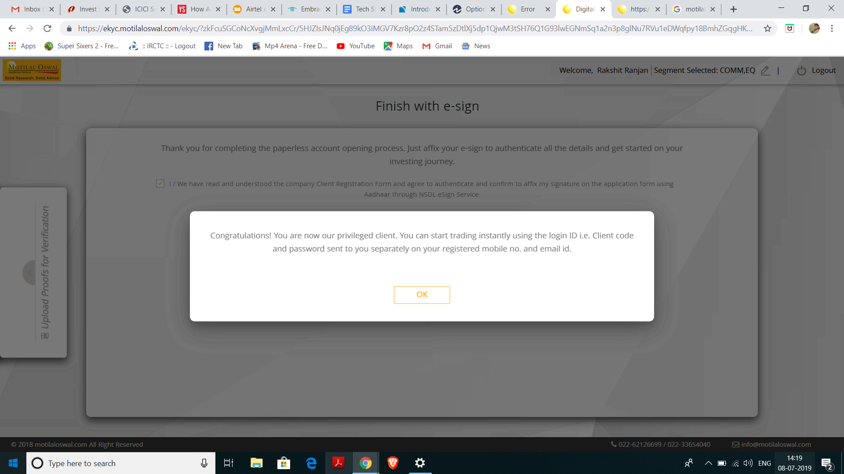
Bank Acc statement/cancelled cheque not asked
Trading account got activated within 30 min

Slide 94
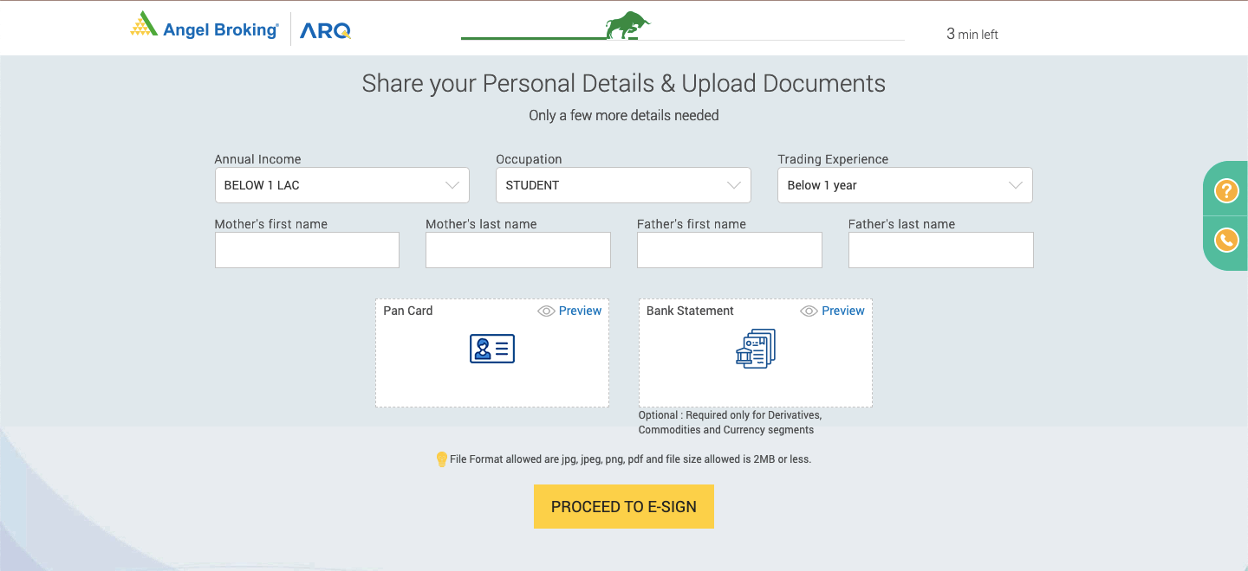
Details
Notes:
Minimal details

Slide 95


Notes:
KRA Fetch

Slide 96

Notes:
eDis

Slide 97

Notes:
Ekyc via UIDAI

Slide 98

Notes:
Multiple Payments

Slide 99
Notes:
Multiple formats

Slide 100
Robo - Appendix

Slide 101



B2B2C – API Integrations
New Channels for Customer Acquisition, New Order Flows

Slide 102




Bambu – B2B
Intelligent Robo Advisor Platform
People Like You!
HSBC Singapore
Walk of Life

Slide 103




Wealth Objects – B2B
Helping Asset and Wealth Managers, Banks, Insurance Companies, Brokerages and many others to launch fully customized omni-channel digital platforms, or to improve their existing offerings.
End to End Robo Advisory platforms, Direct 2 Customer Portals
Custom API’s for internal consumptions
Products like Automated Investing Module, Financial Planning Module, Client On-boarding, Digital Engagement Module
Retirement Planning Platform
Financial Planning Tools & Calculators

Slide 104








We Invest – B2B

Slide 105
API - Appendix

Slide 106

Appendix
Zerodha Kite Details
Ecosystem of Ecosystem
Upstox API Details
API Spectrum
API Technology Suites
Strategic Options

Slide 107





Zerodha’s Kite Connect – API Capabilities
Full Fledged Trading & Investment API’s – HTTP/JSON
2+ Million Trades / Day
200+ Million HTTP Requests / Day
Exhaustive API Documentation for DIY OTT Application development for start-ups & retail investors
Extensive set of Trading APIs:
Login – Authentication, User details
Orders - Place, Modify, Cancel, Retrieve, Multi-legged orders
Portfolio, Holdings, Positions, Convert Positions
Market Quotes, OHLC
Web-socket streaming
Historical candle data, Continuous data
Mutual funds – Place Orders, Place SIP’s
Start-ups & retail investors leveraging to build experiences via OTT Apps/Platforms:
Execute real orders – Equities & Mutual Funds
Obtain live market data
Manage portfolios – Rebalance
Supports API’s across languages & frameworks
More than 10k+ question & answers developer forum
Exhaustive API documentation & support
Embedding buttons on Websites/Apps/Blogs
Better experience for end users, readers of financial blogs, consumers of market analysis
Prospects of added revenue in terms of affiliates
Free of cost
Pricing Model: Rs.2000/ Per Month for Retail Traders
Free for Start-ups

Slide 108
















Ecosystem of Ecosystem
smallcase Publisher Platforms
Rapidly on-boarding new analysts…
Potential 600+ SEBI Registered Research Analysts
Connecting Soon….
Already with 3 brokers… & Google Login
Empanelled Execution Brokers
We are missing here!!!

Slide 109


Upstox API Capabilities
Trading & Investment Products API
Exhaustive API Documentation
Developer Forum with more than 3k topics & 20k Posts
App-API Environment to leverage API’s & create Web App Experiences
Also provide Historical Market Data over API’s
Trade Button for Publishers / Blogs
Rate limiting capabilities

Slide 110

















The API Spectrum
CLOSED API
OPEN API
PRIVATE
Closed API that is accessible to the broker only
PARTNER
Open API That is accessible to our preferred partners
MEMBER
Open API accessible to members belonging to a community
ACQUAINTANCE
Open API accessible to anyone complying with preferred requirements
PUBLIC
Open API accessible to anyone typically involving basic regulation
Need for IBM Connect, Oracle apiary or Google APIGEE

Slide 111











API Technology Suites

Slide 112
Strategic Options
THIRD PARTY DISTRIBUTION
ICICI SECURITIES AS A SUPPLIER
ICICI SECURITIES AS A PLATFORM
Third party
products
Third party distribution
ICICI Securities
ICICI Securities’ products
Third party distribution
ICICI SECURITIES PRODUCTS
THIRD PARTY PRODUCTS
ICICI SECURITIES AS A FULL SERVICE PROVIDER
ICICI SECURITIES AS A PLATFORM
ICICI Securities’ products
ICICI Securities distribution
ICICI Securities distribution
Third party products
ICICI SECURITIES DISTRIBUTION
Notes:
Show the pros & cons of both paths
How to travel through both path ie Journey
Bottom: API
Top: Digital partnerships, Bookmyshow, E commerce

Slide 113
Open API Architecture Attributes
Sr | Feature | Zerodha | Upstox | ICICIDirect.com
1 | Completeness of API Suite | ✓ Equities, Commodities & Mutual Funds | ✓ Equities & Mutual Funds | ✓ Equities & Mutual Funds
2 | Developer Docs | ✓ | ✓ | ✓
3 | App Environment & MIS | ✓ | ✓ | ✓
4 | Wrapper Languages | ✓ (Multiple Languages) | ✓ (Javascript) | ✓ (curl/JSON)
5 | Developer Forum & Support (Github etc.) | ✓ | ✓ | NA
6 | Historical Data for Back-testing | ✓ | ✓ | Plan underway
7 | Publisher API’s (Trade Buttons on News sites, Bloggers, Chart sites) | ✓ | ✗ | Plan underway
8 | Pricing | Rs.2000/Per Month | Rs.750/Per Month | To be planned
9 | Marketing Strategy | ✓ Branded Website inviting Start-ups & Retail Investors to come build on the API’s | ✗ | To be planned

Slide 114


Publisher API’s
Window for customer to Login
Lands on the page to Trade Directly

Slide 115
Social trading
What it is?
Global disruptors?
Indian disruptors?
A micro-investing platform is an application that allows users to regularly save small sums of money. Micro-investing platforms aim to remove traditional barriers to investing, such as brokerage account minimums, to encourage people to invest even if they have limited incomes and assets.
Segment:
Millennials
Small-time investors

Slide 116
Thematic Investing
What it is?
Global disruptors?
Indian disruptors?
A micro-investing platform is an application that allows users to regularly save small sums of money. Micro-investing platforms aim to remove traditional barriers to investing, such as brokerage account minimums, to encourage people to invest even if they have limited incomes and assets.
Segment:
Millennials
Educated investors

Slide 117
Fintech Trend – Payment wallets in Wealth management
What it is?
Global disruptors?
Indian disruptors?
Payment wallet firms with very captive audience are enabling customers to invest instantaneously and offer instant liquidity as well
Segment:
Millennials
Tier 3, Tier 4 cities

Slide 118
P2P Lending as a new Asset Class
What it is?
Global disruptors?
Indian disruptors?
Some Investment fintech startups are partnering with P2P lending firms to provide Lending as an investment options for investors
Segment:
Millennials
Tier 3, Tier 4 cities

Slide 119
Robo advisory with goal based investment
What it is?
Global disruptors?
Indian disruptors?
Some Investment fintech startups are partnering with P2P lending firms to provide Lending as an investment options for investors
Segment:
Millennials
Active traders

Slide 120
Digital innovation Exploration
Micro-investment
Investment Gaming
Personal Finance
Expand to Tier 3,4 cities and Rural geography
P2P lending as an Asset class
Crowd Funding
Savings marketplace
Real Estate investments for retail and mass affluent
Create new markets, target new customer needs
Robo-advisory
Trading tools and investment strategy builder
Can we explore below :
Thematic investment
Algo trading
Pre-IPO investment
Social trading
Wallet-Investment (Yue Bao Model)
Enter adjacent markets and serve adjacent customers
Where to play→
Serve existing markets and customers
Chatbots / Voicebots
WhatsApp
Digital onboarding
Use existing products and assets
Add incremental products and assets
Develop new products and assets
What to offer →

Slide 121


Slide 122


